Slide 1

Component 10 – Fundamentals of Health Workflow Process
Analysis and Redesign
Unit 11 – Maintaining and Enhancing Improvements
This material was developed by Duke University, funded by the Department of Health and Human Services, Office of the National Coordinator for Health Information Technology under Award Number IU24OC000024.
Notes:
Welcome to the Maintaining and Enhancing Improvements Unit. This unit is from the Fundamentals of Health Workflow Process Analysis and Redesign component. This unit focuses on helping the student develop the skills to recognize and access changes that can be maintained. It will also enable the student to develop alternative processes and methods needed to keep the practice running if the EHR system fails and apply to these activities an understanding of health IT, meaningful use, and the challenges practice settings will encounter in sustaining and enhancing the quality improvements that are being made.
Because workflow analysts will encounter organizations and people that have experience with quality improvement as describe in unit 8 an awareness of the methods for maintaining and enhancing improvements is critical. This Unit introduces students to these elements.

Slide 2
Unit Objectives
Upon successful completion of this unit, you should be able to:
  Design control strategies for clinic processes
  Develop and present a sustainability and continuous improvement plan for a healthcare setting
  Work with practice staff to develop a set of plans to keep the practice running if the EHR system fails.
  Work with practice staff to evaluate the new processes as implemented and identify problems and changes that are needed
Notes:
Upon successful completion of this component the student will be able to design control strategies for clinic processes, develop and present a sustainability and continuous improvement plan for a healthcare setting, work with practice staff to develop a set of plans to keep the practice running if the EHR system fails, and work with practice staff to evaluate the new processes as implemented and identify problems and changes that are needed.

Slide 3
Topics – Unit 10.11
CQI
Process Control
Business Continuity Plan
  Natural Disaster
  Pandemic
  Downtime
Notes:
The topics covered in Unit 11 of the Fundamentals of Health Workflow Process Analysis and Redesign Component include:
Continuous Quality Improvement (CQI),
Process Control, and the
Business Continuity Plan which should contain plans to address
Natural Disasters,
Pandemic, and
Computer Systems Downtime.

Slide 4
Sustainability
Important
Realize full potential
Organizational metrics and methods
Notes:
Sustainability of improvements is a very important topic. To realize the full potential of quality improvement projects one must maintain the changes and enhance the changes with subsequent improvements. Not enough is known about what is required to sustain the QI at the organizational level. In this unit we will explore three topics that are useful in tracking, measuring, and encouraging sustainability of the quality improvement.

Slide 5
CQI
The philosophy of continual improvement of the processes associated with providing a good or a service that meets or exceeds customer expectations, in this case, the service of quality health care
Adds an emphasis on understanding and improving the underlying work processes and systems in order to add value
Notes:
CQI is the philosophy of continual improvement of the processes associated with providing a good or a service that meets or exceeds customer expectations, in this case, the service of quality health care. It adds an emphasis on understanding and improving the underlying work processes and systems in order to add value. Shortell, et. al. report that “CQI had come to be widely used in other sectors of the American economy and throughout the world (Deming 1986, Juran 1988) before it was introduced into health care by Berwick (1989) and Laffel and Blumenthal (1989), who wrote seminal articles on the topic, and by a report on an early demonstration program that matched a health care organization with a commercial counterpart (Berwick, Godfrey, and Roessner 1990).”¹

Slide 6
CQI
To achieve continuous quality improvement “it is not enough to do your best …”
Notes:
According to Shortell, research suggests that one-fourth of hospital deaths may be preventable. Thus, it is obvious that processes are needed to increase the improvements and quality gains.
To achieve continuous quality improvement “it is not enough to do your best …”¹
The need to maintain or enlarge improvements in care raises important questions regarding the sustainability of QI programs. In particular, little is known about what is required to sustain QI at the organizational level.

Slide 7
QI Sustainability Motivators
Increase ability to achieve collaborative goals
  More release time (60%)
  Additional money (39%)
Other important motivators were:
  Improving the quality of care
  Professional development
  Personal recognition
  Personal satisfaction
Relatively few respondents were motivated by:
  Career promotion opportunities (10%)
  Fear of negative consequences (18%)
Notes:
The HDC (Health Disparities Collaborative) conducted a survey of investigators in 173 health centers in the Midwest and West Central regions (21 states) that had been involved in QI at least one year as of 2003. In 2004, investigators mailed surveys to each health center’s chief executive officer, medical director, HDC team leader, all HDC team members, and up to three staff members (clinical and non-clinical) who were not part of the HDC team. These were randomly selected from personnel lists. The study of factors of sustainability of QI received responses from one-hundred sixty-five, that is 95% of the health centers in the study. These diverse types of respondents were selected because it was expected that they might have different perceptions of what is needed to sustain QI. After the initial survey, 2 additional waves of the survey were sent to non-respondents and telephone and mail follow-up were used to increase response rates.
Team members, team leaders, medical directors, and CEOs agreed that more release time (60%) and additional money (39%) would help increase their ability to achieve Quality Improvement goals.
Other important motivators were improving the quality of care, professional development, personal recognition, and personal satisfaction.
Relatively few respondents were motivated by career promotion opportunities (10%) or fear of negative consequences (18%).

Slide 8
QI Sustainability Challenges
Time burden of collecting data during initial QI implementation
Funding
Personnel or Staff Turnover (loss of memory of changes)
Decreasing interest and enthusiasm over time
Notes:
Challenges to maintaining and sustaining the improvements are:
Time and resources to perform quality improvement work,
Additional tools and techniques for improving quality, and
Financial reimbursement implications of providing higher quality care.
Enthusiasm for QI may be high when an intervention begins, but may wither once the staff are involved in the day-to-day work and the organization realizes the expense associated with the effort.

Slide 9
Tips for promoting a culture of quality improvement
Educate staff about QI
Set a routine schedule for reviewing data
Communicate results from improvement projects
Display data where patients can see them
Celebrate successes
Articulate the values of QI in meetings
Provide opportunities for all staff to participate in QI teams
Reward staff members in their performance evaluations
Notes:
It is important not to underestimate the people factors, such as culture, in selecting a quality improvement approach. Any improvement (change) takes time to implement, gain acceptance and stabilize as accepted practice. Improvement must allow pauses between implementing new changes so that the change is stabilized and assessed as a real improvement, before the next improvement is made (hence continual improvement, not continuous improvement).
It is easier and often more effective to work within the existing cultural boundaries and make small improvements (that is Kaizen) than to make major transformational changes. Use of Kaizen in Japan was a major reason for the creation of Japanese industrial and economic strength.
Some tips for promoting a culture of quality improvement are:
Educate staff about QI and provide them with the skills to participate in QI processes.
Set a routine schedule for monitoring and reviewing data.
Communicate results from improvement projects throughout the clinic and the
Community.
Display data where patients can see them.
Celebrate successes.
Articulate the values of QI in meetings.
Provide opportunities for all staff to participate in QI teams, and finally
Reward staff members by mentioning their QI contributions in their performance evaluations.

Slide 10
Improvement Worksheet Topics
Primary goal and completion date
  Secondary goals and completion dates
Process problem areas to address (n)
  Potential causes
  Most likely causes
  Root cause
  Ways to streamline the process
  Ways you can modify the process
Notes:
It is also helpful to maintain and make available to all participants Improvement Worksheets that include the following topics:
Primary goal and completion date, as well as
Secondary goals and completion dates.
Process problem areas to address (n) which will include but not be limited to:
Potential causes for the process problems or inefficiencies,
The Most likely causes, and
The Root cause.
Other worksheet topics include ways to streamline the process, and ways you can modify the process to improve the efficiency of the healthcare setting and the safety of the patients.

Slide 11
EHR and Quality Improvement
Data systems that automatically capture and track key clinical information, specifically the metrics of improvement and here the “meaningful use” criteria will make the QI process more efficient and potentially less costly
These systems typically require significant initial financial and social investment
Notes:
More seamless data systems that automatically capture and track key clinical information would make the QI process more efficient and potentially less costly. The challenge is that these systems typically require significant initial financial and social investment. Shields reported in 2007 that 26% of health centers report electronic health record capacity and only 13% meet requirements for a minimal set of functionalities (Shields et al., 2007).
Thus, while implementing a successful EHR is seen as quality improvement in the healthcare setting; the EHR itself can promote and support additional quality improvement in the clinic.

Slide 12
Quality Council
Establish core quality standards
Identify quality metrics
Identify and define quality requirements
Clarify which performance measures are key to gauging actual quality improvement performance
Collect and analyze data to understand key variables and process drivers
Legitimize value of QI to ensure best use of resources and measure improvement associated with these activities
Standardize collection and analysis of quality trends
Educate organization and train key staff
Notes:
A Quality Council may be formed to:
Establish core quality standards,
Identify quality metrics,
Identify and define quality requirements,
Clarify which performance measures are key to gauging actual quality improvement performance,
Collect and analyze data to understand key variables and process drivers,
Legitimize value of QI to ensure best use of resources and measure improvement associated with these activities,
Standardize collection and analysis of quality trends, and
Educate organization and train key staff.

Slide 13
Process Control
Process control (PC) is a statistics and engineering discipline that deals with architectures, mechanisms, and algorithms for controlling the output of a specific process
Statistical process control (SPC) is the application of statistical methods to the monitoring and control of a process to ensure that it operates at its full potential to produce conforming product
Notes:
To be more successful at continuous improvement in health care we must recognize that it encompasses a range of disciplines from PC/SPC to human psychology. Given that the majority of our healthcare professionals have not been exposed to CQI, we may need to provide education and training.
Process control is a statistics and engineering discipline that deals with architectures, mechanisms, and algorithms for controlling the output of a specific process.
Statistical process control (SPC) is the application of statistical methods to the monitoring and control of a process to ensure that it operates at its full potential to produce a conforming product.

Slide 14
Challenges to SPC in Healthcare
SPC is now transferring into Healthcare
SPC was first used in manufacturing industry
SPC is not frequently included in books on medical statistics
SPC is a way of thinking which challenges many of our fundamental assumptions about how to deliver improvement
Notes:
There is evidence that SPC is being increasingly applied in health care
So, why was it not adopted earlier?
SPC was first used in manufacturing industry so there is a reluctance to accept that an approach for improving the quality of “widgets” can be legitimately applied to health care.
In health care we have medical statistics and unfortunately, SPC is not frequently included in the most popular books on medical statistics.
Ultimately, SPC is a way of thinking which challenges many of our fundamental assumptions about how to deliver improvement documented by Deming as referenced in unit 1 - for example, management by objectives, futility of performance related pay, increased quality means increased costs and less production, local optimization results in global optimization.
Past attempts to introduce SPC into health care have failed - not on the statistical arguments but on the reluctance to face the challenges that SPC makes to the overall management approach in healthcare.

Slide 15
Statistical Process Control
Key tools in SPC
  Control charts
  A focus on continuous improvement and designed experiments
Examines a process and the sources of variation in that process
Reduces waste
Reduces the time required to produce the product or service from end to end
Notes:
Key tools in SPC are control charts and a focus on both continuous improvement and designed experiments.
Much of the power of SPC lies in the ability to examine a process and the sources of variation in that process using tools that give weight to objective analysis over subjective opinions. SPC also allows the strength of each source to be determined numerically.
In addition to reducing waste, SPC can lead to a reduction in the time required to produce the product or service, such as a health care visit, from end to end. This may result from using SPC data to identify bottlenecks, wait times, and other sources of delays within the process. Process cycle time reductions coupled with improvements in yield have made SPC a valuable tool from both a cost reduction and a customer satisfaction standpoint.
Shewhart created the basis for the control chart and the concept of a state of statistical control by carefully designed experiments.

Slide 16
Statistical Process Control
Statistical Process Control activities
  Understanding the process
  Understanding the causes of variation
  Elimination of the sources of special cause variation
Monitored using control charts to identify variation due to special causes
Causes for excessive variation must be determined
  Designed experiments
  Pareto charts
Notes:
Statistical Process Control may be broadly broken down into three sets of activities: understanding the process; understanding the causes of variation; and elimination of the sources of special cause variation.
The process is monitored using control charts to identify variation that may be due to special causes, and to free the user from concern over variation due to common causes. This is a continuous, ongoing activity.
When excessive variation is identified by the control chart detection rules, additional effort is exerted to determine causes of that variance. The tools used include designed experiments and Pareto charts.

Slide 17
Features of a Control Chart
Simplicity
Retain information in the data by plotting
  Ease of communication associated with (good) graphs
  Incorporating statistical thinking
Provide guide for continual action
  For common and special cause variation.
Provide reminder that gains lie in reducing common cause variation
Overcome the fundamental limitations and negative consequences of comparison with standards
Notes:
The simplicity of the control chart has inevitably led to its widespread and successful application in manufacturing and service industries.
However, behind this apparent simplicity underlies some important concepts.
For instance, the control chart retains the information in the data by plotting (with respect to order, where appropriate) on a graph and so enjoys the ease of communication associated with (good) graphs while incorporating statistical thinking.
The control chart is a guide to continual action—for common and special cause variation.
The control limits continually remind us that the major improvement gains lie in reducing common cause variation by allowing for the play of chance and not ranking the data, control charts overcome the fundamental limitations and negative consequences of comparison with standards.
It is one of very few statistical methods that complete the hypothesis generation–hypothesis testing cycle of the scientific method, which is one reason for its popularity with practitioners.

Slide 18
Examples of
CONTROL CHARTS
Notes:
The following two slides provide examples of control charts.

Slide 19
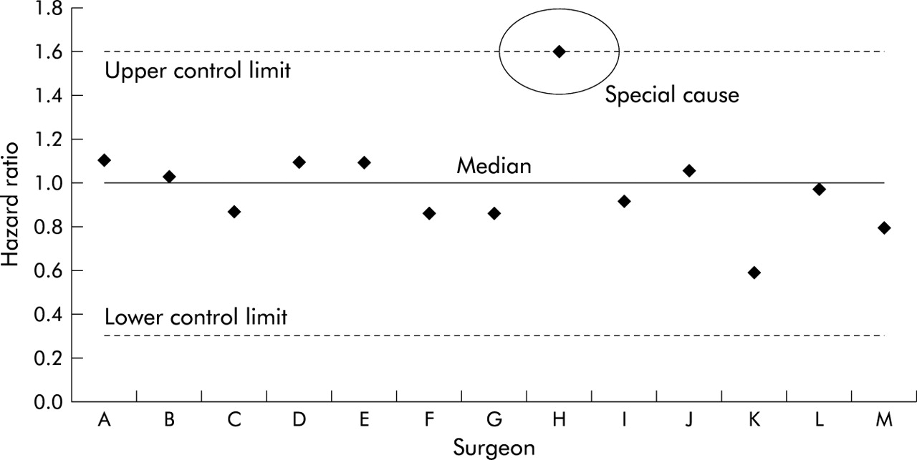

Control Chart of Surgeon Specific Hazard Ratios³
Graph from Mohammed M A Qual Saf Health Care 2004; 13:243-245. Reproduced and distributed with permission from BMJ Publishing Group Ltd.
Notes:
This chart shows surgeon specific mortality rates after colorectal cancer surgery.
Ranking the mortality rates or the adjusted hazard ratios, with or without statistical tests, invites the interpretation that some surgeons are better than others.

Slide 20
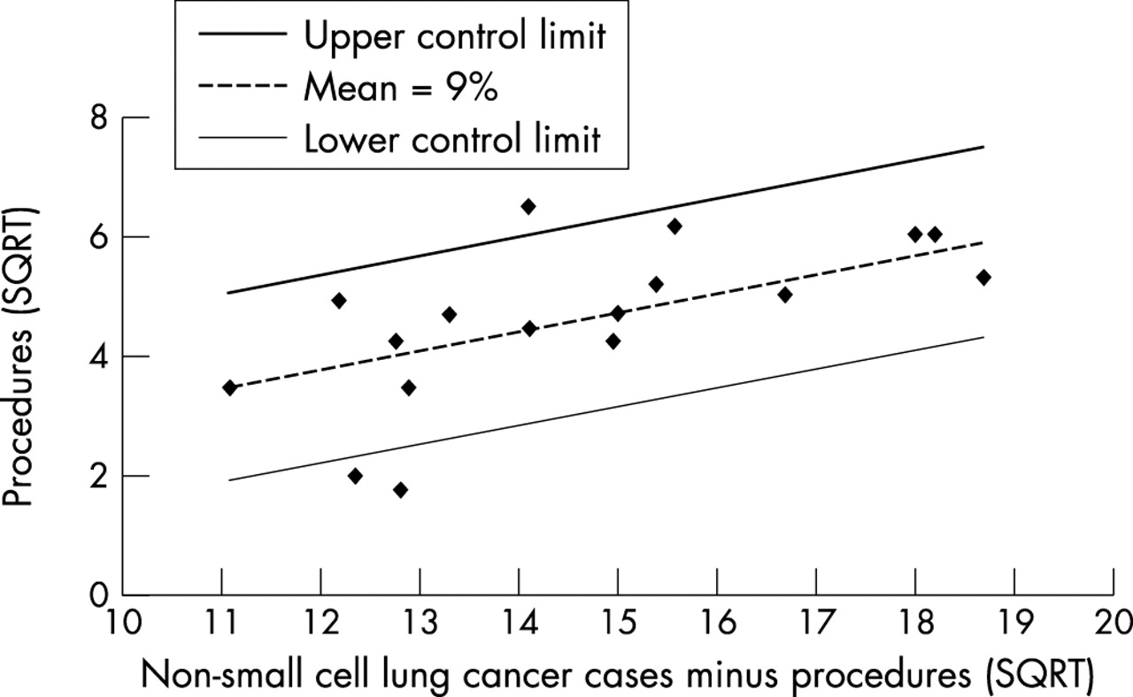

Control Chart of Surgery to Non-surgery Ratio
Graph from Battersby J et al. J Epidemiol Community Health 2004;58:623-625. Reproduced and distributed with permission from BMJ Publishing Group Ltd.
Notes:
This is an example control chart showing the ratio of cases of non-small cell lung cancer undergoing surgery to cases not undergoing surgery (number of cases minus number of procedures) for all persons. The axes are both on a square root scale and each data point represents a primary care trust (PCT). The control limits are based on the mean for all PCTs in Norfolk, Suffolk, and Cambridgeshire of 9% cases undergoing surgery.

Slide 21


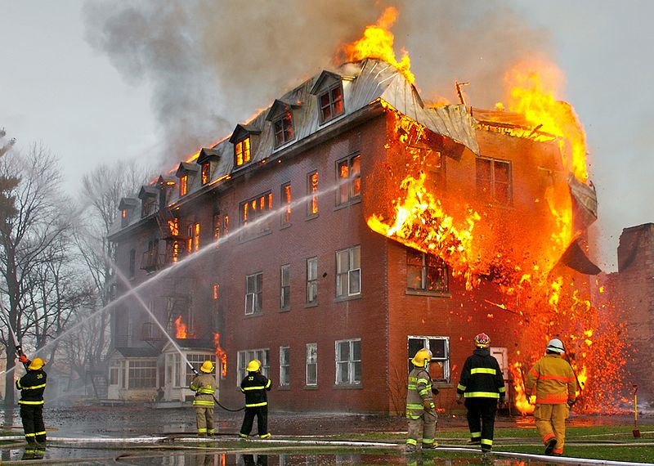
Business Continuity Plan
Public domain photographs, Thunder at Saitama, by masaki ikeda. A fire in Massueville, by Sylvain Pedneault, and Union City Ok tornado by Steve Tegtmeier Obtained from http://commons.wikimedia.org/.
Notes:
The Business Dictionary defines the Business Continuity Plan as a:
“Set of documents, instructions, and procedures which enable a business to respond to accidents, disasters, emergencies, and/or threats without any stoppage or hindrance in its key operations.” ⁴
It provides guidance for times when the organization experiences loss of use of its facility, loss of its vital equipment and systems, and/or loss of key personnel.
Thus, it follows that the BCP is a tool that may be quite helpful in maintaining the improvements in the organization in times of extreme stress such as natural disasters including tornados, fire, hurricanes as well as in the case of complete or near complete computer outages in organizations where the majority of the operations are automated.

Slide 22
Business Continuity
Business Continuity Plan
BCP Team
BCP Objectives
BCP Goals
Essential Functions
Critical Processes
Exercises for Success
Notes:
Business continuity planning is the task of identifying, developing, acquiring, documenting, and testing that will ensure the continuity of the organization’s key operations in the event of an accident, disaster and/or threat. It involves reducing possibility of the occurrence of adverse events and ensuring continued operation in the aftermath of a disaster. In other words, it is the effort to assure that the capability exists to continue essential functions across a wide range of potential emergencies.
Business continuity planning consists of:
Developing the Business Continuity Plan,
Forming a BCP Team to write the plan and in some cases to be activated in case of an emergency,
Identifying the BCP Objectives,
Defining the BCP Goals,
Identifying Essential Functions and Critical Processes that must be restored for the organization to resume operations after the event, and
Developing Exercises and a timetable for testing the plan to ensure that all perform as expected in the case where the BCP needs to be activated.

Slide 23
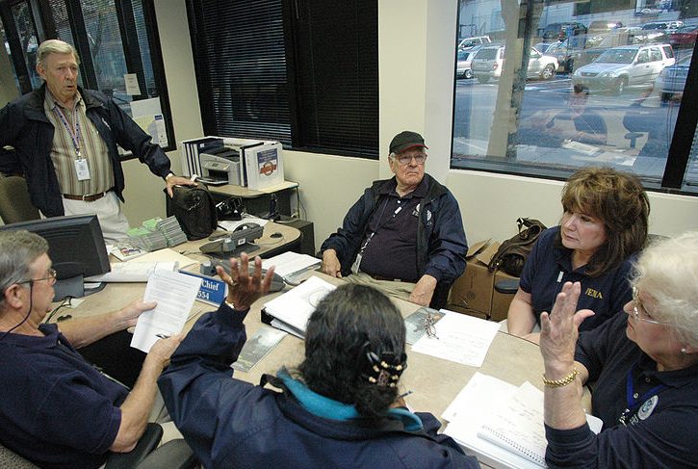
BCP Team
Assemble Core Team to oversee BCP development
Identify BCP
Points-of-Contact
for organizational units
Define the overarching BCP program
Develop a BCP timeline
Public domain photograph obtained from http://commons.wikimedia.org/.
Notes:
An initial step is to assemble a Core Team to oversee BCP development, identify Points-of-Contact for organizational units, define the overarching BCP program, and develop a BCP timeline for implementation. Often this same team is expanded to direct the implementation and continued testing of the plan.

Slide 24
BCP Plan Objectives
Ensure continuous performance of an organization’s mission essential functions in an emergency
Ensure safety of employees
Protect essential equipment, records, and other assets
Reduce disruptions to operations
Minimize damage and losses
Achieve an orderly recovery from emergency operations
Identify alternate locations and ensure operational and managerial requirements are met before an emergency occurs.
Notes:
Typical objectives of BCP plans include:
Ensuring continuous performance of an organization’s mission essential functions in an emergency and safety of employees,
Protecting essential equipment, records, and other assets,
Reducing disruptions to operations,
Minimizing damage and losses,
Achieving an orderly recovery from emergency operations, and
Identifying alternate locations and ensuring operational and managerial requirements are met before an emergency occurs.

Slide 25
Key BCP Plan Goals
Essential organizational functions, vital systems, data and information identified and prioritized
Critical elements capable of being recovered quickly to resume operations
People know who is in charge
Back-up personnel are trained
Alternate work locations are predefined
Checklists are predefined to guide the organization in responding to an emergency
Notes:
Key goals will likely include:
Essential organizational functions, vital systems, data and information identified and prioritized,
Critical elements capable of being recovered quickly to resume operations,
People know who is in charge,
Back-up personnel are trained,
Alternate work locations are predefined, and
Checklists are predefined to guide the organization in responding to an emergency.

Slide 26
Essential Functions
Functions that must be performed to achieve the organization’s mission
Essential Functions include:
  Communications
  Vital Records, Systems and Equipment
  Key Personnel
  Alternate Work Sites
  Testing, Training & Exercises
Notes:
Essential functions are functions that MUST be performed to achieve the organization’s mission. Some examples of essential functions to address include:
Communications,
Vital Records, Systems and Equipment,
Key Personnel,
Alternate Work Sites, and
Testing, Training & Exercises.

Slide 27
Critical Processes
Processes or services that must be recovered within 24 hours after a disruption to ensure resumption of the essential function
Includes all resources necessary to carry out the critical process:
  Personnel
  Data or vital records
  Systems and equipment
Notes:
Critical processes are those processes or services that must be recovered within 24 hours after a disruption to ensure resumption of the essential function.
They include all resources necessary to carry out the critical process:
Personnel,
Data or vital records, and
Systems and equipment.

Slide 28
Exercise for Success
Exercises are events that allow participants to apply their skills and knowledge to improve operational readiness
Goal of exercises is to prepare for a real incident involving BCP activation
Three types of exercises:
  Tabletop
  Functional
  Full-scale
Notes:
Without proper testing, the plan may fail you when you need it the most. Exercises are events that allow participants to apply their skills and knowledge to improve operational readiness. The goal of the exercises is to prepare for a real incident involving BCP activation.
There are three types of exercises,
Tabletop,
Functional, and
Full-scale which are self defining.

Slide 29
References
Shortell, Stephen M., Bennett, Charles, L. and Byck, Gayle, R., Assessing the Impact of Continuous Quality Improvement on Clinical Practice: What It Will Take to Accelerate Progress.
Chin, Marshall H., et al, Sustaining Quality Improvement in Community Health Centers: Perceptions of Leaders and Staff, J Ambul Care Manage. 2008; 31(4): 319–329
Mohammed, M A, Using statistical process control to improve the quality of health care, Editorial in Statistical process control, Quality and Safety in Health Care 2004;13:243-245
http://www.businessdictionary.com/definition/business-continuity-plan.html#ixzz1385PXd8E
Battersby, J., Flowers, J., Harvey, I., An alternative approach to quantifying and addressing inequity in healthcare provision: access to surgery for lung cancer in the east of England Epidemiology and Community Health, Theory and methods 2004;58:623-625
Notes:
These references were used in this unit.

