Slide 1


Working with Health IT Systems
Notes:
http://healthit.ahrq.gov/images/sites/hrsa_health_it_extranet/toolkits_dev/toolbox/hrsa/topics/privacy_security_0.jpg//images.niams.nih.gov/ImageFiles/00015_L.jpg
http://images.niams.nih.gov/ImageFiles/00110_L.jpg

Slide 2
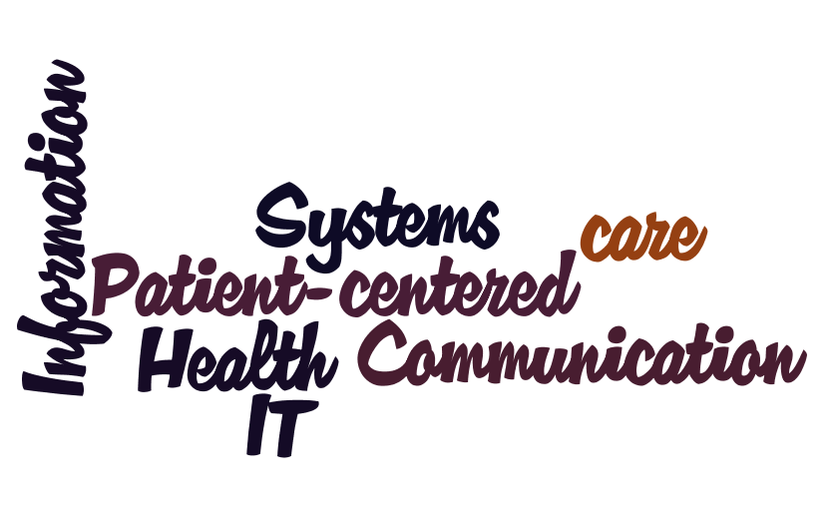
Unit 3: Understanding Information Exchange in HIT Systems
Notes:
Hello and welcome to Unit 3 of Component 7 Working with HIT Systems. This unit, “understanding information exchange in HIT systems,” will present an overview of why HIT systems need to exchange information, and the processes that are evolving to make this happen.

Slide 3
Objectives
Identify entities that are commonly involved in HIT system data exchange
Explain the need for standards and why they exist
Define and differentiate between vocabulary, content exchange, and privacy and security standards
Compare current efforts to facilitate health information exchange between providers, communities, regions and nation (NHIN, HIEs, NHIN Direct)
Notes:
Moving from paper-based health records to electronic systems has the potential to improve the quality, safety and efficiency of all healthcare organizations. Large and complex healthcare organizations in particular are increasingly dependent on HIT systems to manage their operations, keep patients safe, and improve the quality of healthcare services. Within large organizations, there may be several different HIT systems in place to support the operations of various units. For example, in the case of a hospital, there may be HIT systems in place for laboratory, radiology, pharmacy, surgery, and administration. The better these various systems are able to “talk to each other” and exchange data, the more effective providers will be in delivering care. Interoperability is the term we use to describe these systems’ ability to exchange data. Interoperability is critical to the success of an EHR, which must consolidate information from various systems into a single comprehensive record of a patient’s health.
For smaller healthcare organizations, particularly for physician private practices, the number of HIT systems in use is likely to be much smaller. In many cases such practices may only have an electronic practice management and billing system in place. As the meaningful use criteria roll out, increasing numbers of these practices will start to employ EHR systems to replace paper records. These system will be required to interoperate and exchange data with hospital systems, practice management systems, and other providers.
Beyond the interoperability of HIT systems in use within a single healthcare organization, it is important that exchange of information also be possible between organizations, as well as with the patient. This interoperability and data exchange are core to achievement of meaningful use.
This unit will focus on the type of information exchange that occurs in various healthcare settings. The objectives include identifying entities that are commonly involved in HIT system data exchange (entities may include healthcare organizations, patients, electronic monitoring devices, researchers, government agencies, etc.), then to explain the need for standards and why they exist. We will define and differentiate between various types of interoperability standards, and compare some of the current efforts to facilitate information exchange between organizations, including Health Information Exchanges (HIE) and the National Health Information Network or “NHIN”.

Slide 4

Types of Information
Exchange
Exchange of information between systems used by a single health care organization
Exchange of information between HIT systems of 2 or more different organizations/entities
Notes:
When thinking about information exchange between HIT systems, it is helpful to distinguish between information exchange that happens between systems owned and operated by a single provider (a hospital or professional), as opposed to information exchange that happens between different providers or between a provider and a patient.
Let’s look at a couple of examples.
http://media.photobucket.com/image/Information%20healthcare/KUBUOman/health-information-technology.jpg

Slide 5
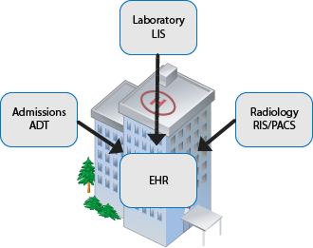
Types of Information
Exchange
Exchange of information between systems used by a single health care organization
Notes:
When we talk about an electronic health record (EHR), we are referring to a system that records, tracks, and maintains information about patients and their health. We often think about an EHR as a single “thing.” While it is certainly possible to implement a single software solution that might meet all of the electronic recordkeeping needs of a healthcare organization, in most healthcare organizations there are numerous systems that interact and exchange data. In such cases, the interoperability of these systems is critical to patient safety, usability, and workflow efficiency in a health care organization.
The example pictured here is that of a hospital, which has separate information systems in place that correspond to separate functional units within the hospital. Hospital admissions uses a system to register and admit patients to the hospital (commonly referred to as ADT, for “Admission, Discharge, Transfer”). Radiology uses a radiology information system (RIS) tied to a picture archiving and communication system (PACS) to manage imaging workflow and electronic storage of radiology results. Results from labs are tracked in a laboratory information system (LIS). Finally, details of a patient’s medical history and problem lists are stored in the electronic health record (EHR). This is just a small sampling of the various information systems that may be in use by various departments within the hospital.
Ideally, the EHR within the organization is able to connect to all of the other systems to provide a complete health record for a given patient as well as to provide a view across patients. A provider using the EHR system should, for example, be able to review radiology results for a patient at the point of care, submit a lab order (using computerized provider order entry, or CPOE, functionality within the EHR), and have the lab results return and integrate into the patient’s record.

Slide 6
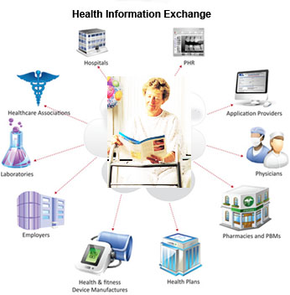
Types of Information
Exchange
Exchange of information between HIT systems of 2 or more different organizations/entities
Notes:
The second example demonstrates a different type of information exchange of health information. Unlike the first example, where all of the various systems within the hospital are all controlled by that single organization, there are many instances when it would be beneficial for different organizations to exchange information. In fact, the exchange of information may not just be between organizations (which might include the hospital, the doctor’s office, a pharmacy, public health agencies), but also directly with the patient. The electronic movement of health-related information among organizations, also known as health information exchange (HIE), presents special challenges related to ownership of data, privacy, and security considerations that are not as difficult to address within a single organization. However, standards and initiatives exist and are continually improving to address these challenges. Health information exchange is a foundational aspect to achieving the meaningful use criteria. We will cover this in more detail later.

Slide 7
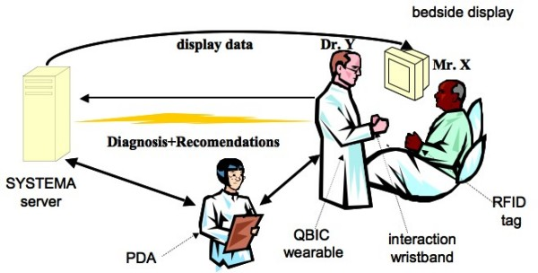
Information Exchange Use Case
Picture or animation here showing a journey of an individual through the healthcare system
Notes:
To demonstrate this information exchange more concretely, let’s look at a use case of an individual traversing through various healthcare institutions. (A use case describes "who" can do "what" with a system, and is a helpful tool to use to define functional specifications for HIT systems.)
An individual, John Smith, moves to a new city to start a new job. He finds a new doctor, who is able to transfer all of his health records from his previous provider electronically into the practice’s EHR system. John gets sick, goes to his doctor who orders a lab. John visits the diagnostics center to have the lab work completed, which is transferred electronically back to the doctor. The doctor reviews the results in the EHR system, looks up which medications John’s insurance provider covers in the preferred drug list, then electronically submits a prescription to John’s preferred pharmacy. John becomes so sick that before he can pick up the prescription, his wife takes him to the emergency room at the local hospital. The hospital is able to obtain his medical history electronically from his doctor’s EHR system, and begins treatment immediately. Details of John’s condition, which the hospital had seen many cases of that day, were sent to a public health agency. John recovered, and was sent home with discharge instructions printed from the hospital EHR system, and also an electronic document that he uploaded to his personal health record (PHR) at home.
Parts of this use case of information exchange are not yet possible for many in the country today, but will become more widespread as consumer demand and government incentives lead healthcare providers and institutions to implement interoperable HIT systems.
http://www.esl.fim.uni-passau.de/page/uploads/pics/gespag_small.jpg

Slide 8

“Meaningful Use” and HIT Information Exchange
Incentive program will require:
  Demonstration of interoperability
  Share electronic data with patients
  eRx
  Quality measures reporting to CMS/States
  Drug formulary checks
  Medication reconciliation
  Summary of care records for transfers/referrals
  Immunization reporting to registries
  Syndromic surveillance reporting to public health agencies
  Lab results reporting to public health agencies
  Patient reminders
  Direct patient access to their record in an EHR
Notes:
Why is interchange so important? The United States Congress supports the promotion of HIT and health information exchange, and enacted the Health Information Technology for Economic and Clinical Health Act (HITECH Act) in 2009. This act directs the Secretary of the Department of Health and Human Services to adopt standards, implementation specifications, and certification criteria for HIT that will include specific requirements for information exchange. An eligible healthcare professional or hospital that participates in Medicare or Medicaid will eventually be required to implement HIT that makes “meaningful use” of electronic health records. Where there are specific standards that are widely accepted, meaningful use requires their use for representing information in an EHR (for example, storage of lab results using LOINC). Requiring use of common standards will facilitate easier movement of this information between different systems. With regard to HIT information exchange, the meaningful use criteria will necessitate interoperability between EHR systems and other entities’ systems by requiring the EHR systems to:
Demonstrate interoperability between the EHR and at least one patient-authorized entity.
Share information electronically directly with patients
Electronic prescribing of medications, and
Reporting clinical quality measures to CMS or states.
The meaningful use requirements also specify a “menu set” of options, only a portion of which are currently required, at the discretion of the hospital or professional. Of these menu set options, ones with health information exchange implications include requiring EHRs to enable a user to perform:
drug formulary checks
medication reconciliation between care settings
summary of care records for transfers or referrals
reporting to immunization registries
syndromic surveillance reporting to public health agencies
laboratory results reporting to public health agencies
patient reminders, and
direct patient access to their EHR information.
See full size image
756 × 504 - 99k - jpg - www.nyacp.org/images/KS110062.jpg
Image may be subject to copyright.
Below is the image at: www.nyacp.org/i4a/pages/index.cfm?pageid=351

Slide 9
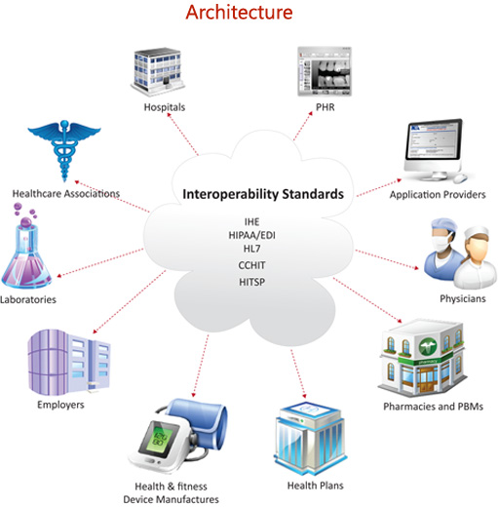
Interoperability of Systems
Proprietary vs. standard methods of exchange
Why are standards
important?
Notes:
Computerized information systems have always been able to exchange data—these systems often wouldn’t be of much use to us if they couldn’t. How one software system exchanges information with another software system, however, may be very dependent on the vendor or vendors that created the systems. Let’s take for example an email system. We take for granted now that we can compose an email message to a friend using whatever email software and email provider we prefer, and as long as we have the correct email address for the friend, we can be reasonably sure that the message we send will be received. We don’t have to know what kind of email software the friend is using or who provides email service to our friend. But in the past, before the growth of the Internet as a consumer network, email systems often were proprietary (think AOL, CompuServe, Prodigy)—meaning they used methods of exchanging data that only worked with systems developed by a single vendor, or a small set of cooperating vendors. So if I wanted to send an email message to a friend, I had to hope she used the same email provider that I was using. The demand to be able to send email to anyone, regardless the online service a person might use, led to the adoption of standards for email that we now take for granted. Standards and the demand for interoperability in HIT are just now beginning to emerge.
So what exactly are standards and why are they necessary? We have existing networks that connect organizations already (it’s easy to get on the Internet, after all), so why can’t we simply use these networks to exchange information now? Well, imagine an organization with an EHR that stores patient demographic information that includes a field for “Patient Age.” A different healthcare organization also has an EHR, but instead of containing a field for the patient’s age, the EHR has a field for “Date of Birth.” Both EHR systems likely store the same kind of patient demographic information, but in this case the lack of standard representations for the same piece of information of these systems defeats the opportunity for interoperability, since the information stored in the “Date of Birth” field is not directly transferable to the other system’s “Patient Age” field (manipulation of the date of birth data would have to be done to calculate the patient age).
This example demonstrates why standards are so important. If the EHR systems for these two organizations used a common standard for representing a patients age, even something as simple as defining the field types for patient demographic information, it would be possible to directly move this piece of data from one system into the other. Multiply this simple example by the thousands of pieces of healthcare data that are exchanged everyday and you will understand both the need and the complexity.

Slide 10
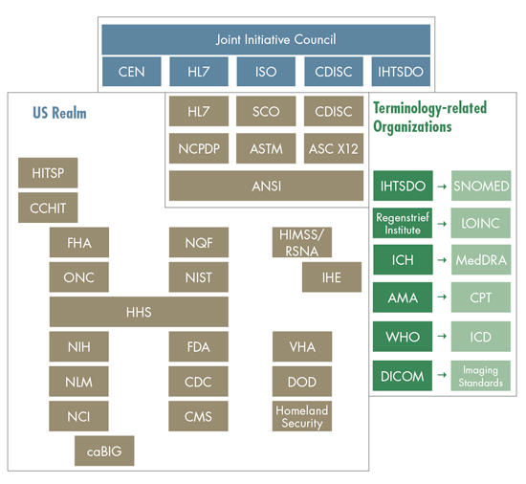
Types of Standards
Vocabulary, content exchange, and privacy and security standards (including transport standards)
  Vocabulary: code sets, ICD-10-CM, SNOMED CT, LOINC
  Content exchange: HL7 CDA R2 CCD, ASTM CCR
  Privacy/security: AES encryption, IPsec, TLS
  Transport: SOAP, REST
Notes:
In the previous example, a standard way of storing patient demographic information in an EHR is just one type of standard that would be necessary for ensuring that patient data between the systems was interoperable. There are several other types of standards that would be necessary to get a complete patient record from one EHR into another. The meaningful use guidelines group these standards into three different categories:
Vocabulary Standards
Content Exchange Standards
Privacy and Security Standards
Vocabulary Standards are the standardized nomenclatures and code sets used to describe clinical problems and procedures, medications and allergies.
A patient record in an EHR will contain information about that patient’s clinical problems. Vocabulary standards define how those problems are stored in the EHR. It wouldn’t be advisable to store a medical diagnosis in a text field, given that someone might describe a problem as “diabetes” while another person lists “diabetic”. A subsequent report to a public health agency might inadvertently leave off the patient whose record had “diabetic” listed instead of “diabetes”. It is better in such case to use a code (such as a number) to represent common diagnoses.
Content Exchange Standards are the standards used to share clinical information such as clinical summaries and prescriptions, using structured electronic documents.
These standards define, for example, how a clinical summary of a patient record from one EHR systems should be packaged for transfer to another EHR system. Since such a clinical summary will include clinical problems, medications, and allergies, you can see how there is interplay between the various standards—the content exchange standard would also contain data formatted according to vocabulary standards (for defining problem lists, laboratory results, etc.) and also utilize privacy and security standards to define how the data is securely transported from one EHR to another.
Privacy and Security Standards — Standards relating to authentication, access control, transmission security which relate to and span across all of the other types of standards.
Privacy and security standards are important for defining how data within HIT systems are protected from inappropriate divulging of sensitive information. Such standards might define, for example, how files are physically stored on hardware storage devices, to ensure that inappropriate tampering with the storage device cannot be used to steal private healthcare data.
Reference: http://www.healthreformwatch.com/2010/02/08/things-you-wanted-to-know-about-the-new-hit-standards-but-were-too-afraid-to-ask/
Healthcare standards image - http://library.ahima.org/xpedio/groups/public/documents/graphic/bok1_043987.jpg

Slide 11
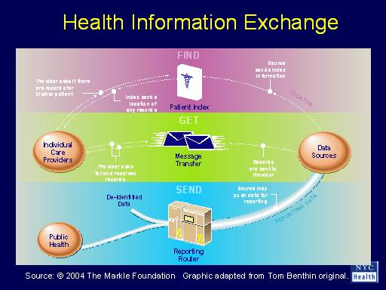
HIE Initiatives
Health Information Exchange (HIE)
“The electronic movement of health-related information among organizations according to nationally recognized standards.”¹
HIO, RHIO
Examples: HealthBridge, Indiana HIE, CareSpark, MedVirginia
NHIN
Notes:
Health Information Exchange (or HIE) is a term used to describe the process of sharing health information electronically among two or more organizations, according to nationally recognized standards. HIE has also been used to describe an entity that provides the infrastructure and services to facilitate the sharing of health information, but it is better to refer to such an entity as a “Health Information Organization” or HIO. A “Regional Health Information Organization”, or RHIO, is a type of HIO that brings together health care stakeholders within a defined geographic area and governs health information exchange among them for the purpose of improving health and care in that community.¹
The benefits of HIE initiatives include facilitating access to health related data to provide safer, more timely, efficient, effective, equitable, patient-centered care. HIE initiatives also have the potential to improve the ability of public health authorities to assist in analyses of the health of the population. A health information organization makes relevant healthcare information available where and when it is needed, potentially reducing healthcare costs by eliminating duplication of services. For example, a provider who can gain easy access to a patients health information through an HIO does not have to devote time and resources to redo the work that has already been done by other providers (such as laboratory tests, physical examinations, establishing medical history, etc.). In the case of a health emergency, quick and easy access to patient information could mean the difference between life and death. So HIOs have the potential to greatly increase the quality of healthcare while at the same time reducing costs.
The landscape for health information exchange is rapidly developing, and should continue to expand as providers begin full scale implementation of EHR technology to meet meaningful use requirements. Some pioneering examples of RHIOs include HealthBridge (Southwest Ohio, North Central Kentucky and South Eastern Indiana regions), Indiana HIE (Indiana statewide network), CareSpark (Tennessee and Virginia), and MedVerginia (central Virginia).
As the number and quality of RHIOs continue to expand, the next logical step is to connect these networks together to form a national network for health information exchange. The Nationwide Health Information Network, or NHIN, is an effort led by the Office of the National Coordinator for Health Information Technology (ONC) to build a national exchange. Current participants in the NHIN include the Social Security Administration (SSA), MedVirginia, the Department of Veterans Affairs (VA), the Department of Defense (DoD), Centers for Disease Control and Prevention (CDC), and Kaiser Permanente.
As providers move from paper-based records to interoperable electronic systems, they will be better prepared to participate in HIE efforts. Meaningful use requirements will continue to evolve, placing greater emphasis on the need for HIT systems to facilitate health information exchange between patients, providers, public health entities, federal and state government agencies, and research organizations. The expansion of HIE efforts, including RHIOs and the NHIN, will help healthcare providers reduce costs, increase quality and provide a more satisfying experience for patients.
¹National Alliance for HIT Report to the ONC on Defining Key Health Information Technology Terms (April 28, 2008), http://www.hhs.gov/healthit/documents/m20080603/10_2_hit_terms.pdf
See full size image
512 × 384 - 30k - jpg - www.ahrq.gov/.../mostashari2/Mostashari2-9.jpg
Image may be subject to copyright.
Below is the image at: www.ahrq.gov/.../mostashari2/Mostashari2-9.htm

Slide 12
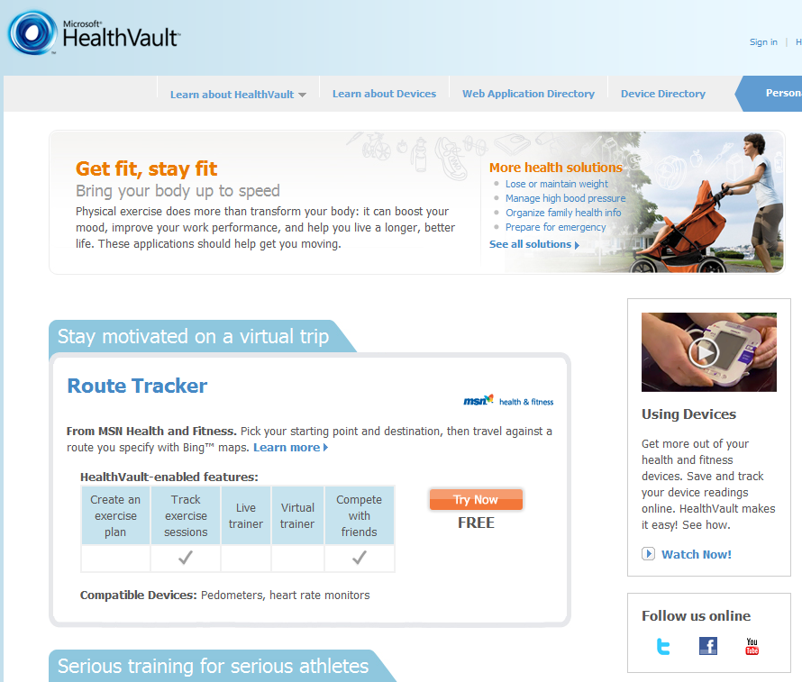
Unit 3 Summary
Entities that are commonly involved in HIT system data exchange
The need for standards and why they exist
Vocabulary, content exchange, and privacy and security standards
Health information exchange between providers, communities, regions and nation (NHIN, HIEs, NHIN Direct)
Notes:
To summarize, in this unit we have explored the various entities that are involved in information exchange, considering the type of interoperability that is ideal for systems within a single organization, as well as the concept of Health Information Exchange (HIE), which is the exchange of information between 2 or more providers, as well as between a provider and patient. We examined the need for common standards for exchange of information rather than proprietary storage and exchange of information. We talked about different types of standards, specifically vocabulary, content exchange, and privacy and security standards. Finally, we looked at local and national initiatives for health information exchange, including formal health information organizations (state and regional health information organizations) and the Nationwide Health Information Network (NHIN).

Slide 13
References
National Alliance for HIT Report to the ONC on Defining Key Health Information Technology Terms (April 28, 2008)
http://www.hhs.gov/healthit/documents/m20080603/10_2_hit_terms.pdf
National Library of Medicine HIT standards
http://www.nlm.nih.gov/healthit.htm
Notes:
This concludes Unit 3

