Slide 1

Working in Teams: Unit 3
Initial Tools for Teaming: Ground Rules and Action Plans for HIT Teams
Notes:
Welcome to Working In Teams: Unit 3 Initial Tools for Teaming: Ground Rules and Action Plans

Slide 2
Unit 3 Objectives
At the end of this unit the learner will be able to:
Create and describe SMART ground rules.
Develop and refine a team action plan.
Establish ground rules and an initial action plan for an HIT team.
Notes:
At the end of this unit the learner will be able to:
Create and describe SMART ground rules.
Develop and refine a team action plan.
Establish ground rules and an initial action plan for an HIT team.

Slide 3
Unit Outline
Overview of Team Member Expectations and Ground Rules
Setting team ground rules
  Setting ground rules
  SMART ground rules
  Examples of ground rules
  Activity-Developing Ground Rules
Development of an Action Plan
  Purpose of an Action Plan
  Elements of an Action Plan
  Tools for Action Plans (PERT, MS Project, WBS, Gannt)
  Activity– Create an Action Plan
Tools for Teaming
Activity – Create Ground Rules for an HIT team
Summary/Conclusion
Notes:
The outline of this unit is as follows: we will begin with an overview of team member expectations how they link to ground rules, then we’ll look at setting team ground rules, smart ground rules and having some examples of ground rules and ending in an activity where you will develop ground rules. We’ll then look at the development of an action plan – its purpose and elements – and tools that can help with action plan development. We’’ end that section with that with an activity where you will create an action plan. We’ll look at a few other tools for teaming – then you’ll have an opportunity in another activity to create ground rules for a specific HIT team. Finally, we’ll end with the summary and conclusion of this unit.

Slide 4

Team Member Expectations and Ground Rules
Coach John Wooden’s six rules for creating an effective team included (Wooden, J, 2007):
Consider team spirit and morale.
Be alert to spot the good competitors and the poor ones.
Be alert for potential troublemakers and get rid of them.
Give each individual a fair chance and every opportunity he or she earns.
Consider fight, determination, courage, and desire.
Look for cooperation and good attitude.
Notes:
Team Member Expectations and Ground Rules: The legendary coach and mentor to basketball players for decades, the late John Wooten, writes about his leadership and team building experiences in his book, The Essential Wooden. In that book, He states that in order to establish anything as a leader and to build your team, you must really believe in what you are doing. In fact, all team members must believe in what they are doing, But If you have a question in your mind, the team is going to question it as well. and it will be a pretty rough time. Each member of the team must believe in what they are doing – if they are in doubt, it’s time to start thinking about change. Coach Wooten also sets some guidelines and roles for the numerous teams that he has coached. Or been on over the years. He provides six rules for creating an effective Team and those rules are n screen now.

Slide 5
Setting Team Ground Rules
Ground rules should focus on three elements:
  Tasks – Expected activities and deliverables for the team.
  Process – How the activities will be carried out.
  Norms – Ways in which team members will interact with each other.
Notes:
Setting Team Ground Rules. When a team first starts working together, they cannot just focus on getting the work done, but they must consider HOW the work will get done. Ground rules are consciously established to help individual members how to act. And the rules are an important tool for helping individuals function together as a team. They address how individuals should treat each other, communicate, participate, cooperate and, in all cases, coordinate their joint activity. These rules reflect what is important to team members about how they will work together. They may be used to define and standardize team procedure – the use of time, work assignments, meeting logistics, preparation, minutes, discussion, creativity, reporting, problem solving and handling conflicts. These fall into one of three elements, rules that are focused on tasks, rules that are focused on the activities that will be carried out, and rules that are focused on norms. Where clear ground rules are missing, natural behavior patterns often emerge spontaneously. Those are what are often what we refer to as norms.
University of Minnesota, Office of Human Resources, http://www1.umn.edu/ohr/toolkit/workgroup/forming/rules/index.html
When a team first starts working together, they cannot just focus on getting the work done, but they have to consider how the work will get done. Ground rules are consciously established to help individual members to decide how to act and are an important tool for helping individuals function together as a team by addressing how individuals treat each other, communicate, participate, cooperate, support each other, and coordinate joint activity. These rules reflect what is important to the team members about how they work together. They may be used to define and standardize team procedure, use of time, work assignments, meeting logistics, preparation, minutes, discussion, creativity, reporting, problem solving and handling conflicts. These fall into one of three elements – Tasks, Process or Norms.
Where clear ground rules are missing, natural behavior patterns often emerge spontaneously. These are referred to as norms.

Slide 6
Setting Team Ground Rules
Ground rules are an important tool for helping individuals function together as a team. They should be:
  Clear
  Concise
  Consistent
  Agreed-to
  Followed
  Re-enforced
  Updated
Notes:
Ground rule should be established as early as possible – preferably at the first meeting. All team members should be involved in, provide input, and agree with the ground rules. Remember, your team members can be coming from diverse backgrounds, with multiple perspectives and this is the opportunity to establish some consistent parameters. Consider your previous experience in working in teams and what has worked well and what hasn’t. Determine how you would like to see this team work. Write down the agreed upon ground rules and publish them to all team members. All members of the team must be diligent about following and reinforcing these rules through remeinders and team process checks as the team works together. The team can determine a process monitor to assure that ground rules are followed and are effective. This is a good example of a pre-defined team role that is assigned on sa rotating basis. That is, you may be process monitor for one week and someone else has the next week. This gives credence to the process and helps keep things on track. Updates may be required to the groundrules ss you proceed further along your path towards success.
Team Ground Rules by Kenneth Crow, DRM Associates, www.npd-solutions.com/groundrules.html
Ground rules should be established as early as possible, preferably in the first meetings. All team members should be involved in, provide input and agree with the ground rules. Remember your team members can be coming from diverse backgrounds with multiple perspectives and this is the opportunity to establish some consistent parameters. Consider your previous experiences in working in teams and what has worked well and what hasn’t. Determine how you would like to see this team work. Write down the agreed upon ground rules and publish to all team members. All members of the team must be diligent in following and re-enforcing these rules through reminders and team process checks, as the team works together. (The team can determine a “process monitor” to ensure that ground rules are followed and are effective. This is a good example of a pre-defined team role that can be assigned on a rotating basis. This gives credence to process and helps keep things on track.) Updates may be required as you go along.
Handout – Steps in Setting Ground Rules (University of Minnesota, Office of HR, http://www1.umn.edu/ohr/toolkit/workgroup/forming/rules/index.html)

Slide 7
Setting Team Ground Rules
Ground rules should be:
  Clear
  Concise
  Consistent
  Agreed-to
  Followed
  Re-enforced
  Updated
Process Monitor
Notes:
Here are some examples about setting clear ground riles – ground rules should be clear. Concise, and consistent. They also should be agreed to by everyone on the team, followed, reinforced, and updated. And those four final elements might best be monitored by an individual called a process monitor. This was mentioned on a previous slide. Here are four specific areas that the process monitor could be watching during their week playing the role of process monitor. Again the suggestion is that this be a rotating responsibility. It gives everyone the opportunity to delve into the value of each of the ground rules and gives credence to the process. It helps keeps things on track and gives each team member a vested interest during that week – a higher level of interest and a better appreciation for the power of ground rules.
All members of the team must be diligent in following and re-enforcing these rules through reminders and team process checks, as the team works together. Note - The team can determine a “process monitor” to ensure that ground rules are followed and are effective. This is a good example of a pre-defined team role that can be assigned on a rotating basis, ex: a different team member is the process monitor every week. You can go even further and assign 5 minutes during every team meeting to the process monitor (Rick feel free to flesh this out, word it better with your example.) and is responsible in team meetings to make sure the team is following, re-enforcing and updating the ground rules. This gives credence to process, helps keep things on track and gives each team member who has the responsibility an higher level of awareness and importance of staying on top of process.
Any project is a continuing, evolving process so updates may be required as you go along – but with any updates they need to be clear, concise, consistent and remember – agreed-to.
Handout – Steps in Setting Ground Rules (University of Minnesota, Office of HR, http://www1.umn.edu/ohr/toolkit/workgroup/forming/rules/index.html)

Slide 8
SMART Ground Rules
Ground rules should be written to be:
  Specific
  Measurable
  Attainable
  Relevant
  Timely (Time Bound)
Notes:
We have discussed how important ground rules are for your team and the process around writing and maintaining them. Now let’s dive down a little deeper regarding how the ground rule is written – the clarity of the ground rules. When creating your team ground rules, they should be written as SMART ground rules. Specific, Measurable, Attainable, Relevant, Timely (Time Bound).
Think up a ground rule. Something that you believe would help a team be successful.
Specific - Is it specific? Is it a clear statement of what you want to achieve? If it is too broad, break it down into smaller chunks. something that is very specific. It will help you gain clarity, direction, motivation and focus.It will also help you to assess and maintain the delivery on that ground rule.
Measureable – does it include decisive factors which can be quantified? This can allow you to determine your progress toward goal attainment. Decisive factors can include an amount, number, extent, size, or frequency.
Attainable – is it realistic enough to be within you or your team’s each? Consider if achievement of this goal will be possible under your typical working conditions.
Relevant - related or linked to the essential tasks or functions for your team.
Timely - Is it able to be accomplished within the timeframe that has been established?
If you can work these SMART ground rules into the pattern for your team development, your team will be well on its way toward a successful outcome.

Slide 9

Examples of Ground Rules
Here is an example of one team’s rules:
Project objectives are measurable and can be achieved in the short term.
Project work plan and implementation plan are clearly defined.
The problem is studied before a solution is created.
Meeting minutes are posted and feedback is provided.
Skeptics are involved on the Team.
Team members communicate daily with each other.
Notes:
Although each team should be setting their own ground rules, and it should be one of the first things if not the first thing that they do. Here’s an example of one team’s set of ground rule – these ground rules are very specific to the project and orientation of this team. Your ground rules should be specific to your project and the orientation of the team as well as being somewhat fitted or aligned with the cultural expectations of your organization.
Imaging what would happen to the team if rules were not set and mutually agreed upon? I can think of a few examples that include:
Role confusion
Disrespect
Poor communication
Breakdown of tasks and responsibilities
Project doesn’t move forward
Duplication of efforts
Poor working environment and chaos with the task development

Slide 10
Activity I: Developing Ground Rules-Personal Reflection
Consider a team you were a member of that was a very positive and successful team experience. List between 4 and 6 key reasons you believe that team experience to be positive and successful.
Next, consider a team you were a member of that was not a positive nor a successful team experience. List between 4 and 6 key reasons you believe that team experience to be neither positive nor successful.
Notes:
Activity I: Developing Ground Rules-Personal Reflection
FIRST, Consider a team you were a member of that was a very positive and successful team experience. List between 4 and 6 key reasons you believe that team experience to be positive and successful.
Next, consider a team you were a member of that was not a positive nor a successful team experience. List between 4 and 6 key reasons you believe that team experience to be neither positive nor successful.

Slide 11
Activity I: Developing Ground Rules-Personal Research
Now that you have reflected on your own experiences with teams, both positive and not so positive, spend some time researching what others have provided as guidelines or ground rules for working in teams. Write an abstract (200 words maximum) that displays insights from two independent reference sources.
Next, develop a listing of 6 key ground rules that you would recommend be considered by your next team.
Notes:
Activity I: Developing Ground Rules-Personal Research
Now that you have reflected on your own experiences with teams, both positive and not so positive, spend some time researching what others have provided as guidelines or ground rules for working in teams. Write an abstract (200 words maximum) that displays insights from two independent reference sources.
Next, develop a listing of 6 key ground rules that you would recommend be considered by your next team. And you should do this having reflected on your experiences with positive and not so positive teams and the experience you gained from the research on this topic.

Slide 12

Why Create an Action Plan?
“By failing to prepare, you are preparing to fail.” – Benjamin Franklin
Notes:
Why create an action plan? To paraphrase Benjamin Franklin, If you fail to plan, you plan to fail. The action plan should drives the initial action by the team. It should clarify the mission and end goal of the team and designate specific tasks with specific dates and specific people responsible.

Slide 13
Action Plan Preparation
Clearly define goal(s) or mission
Clearly define parameters/scope of the project
And what is NOT part of the goal or in-scope
Ask: Who, What, Where, When, Why and How
Who?
What?
Where?
When?
Why?
How?
Notes:
Now that you have set clear team ground rules and know how the team is going to work together, it is important to take the time to be clear on what the team is going to work on – it can be as simple as a clearly defined SMART goal or as complex as the project scope for a multi-year, multi-phased, global initiative.
What is key here is that whatever you are working on, the team is clear regarding what the exact goal is or what the parameters or scope of the project is. This sets the same expectations for all team members allowing everyone to understand and work to the same end. Also the more you understand your goal the more comfortable you will feel undertaking it. Take the time up front to clarify this by asking the simple questions – Who, What, Where, When and How? This is the basis for developing your team’s Action Plan.
Include not only what is part of the goal but what is NOT part of the goal or in scope. This will also decrease misunderstanding and wasted effort if a team member, with good intent, puts effort towards work that does not fall within the goal.

Slide 14
Action Plan Example
Action No. | Action | Goal/Result Area | Target Date | Owner | Originator | Start Date | Date Completed | Comments
Notes:
There are many types of plans that can fall under the umbrella of action plans- a basic action plan template that states who/what/where/when/how that can be used as a reference and updated as you go, like this one. There are Work Breakdown Structures, Pert Charts, Gantt Charts and other project management frameworks used in project management. There are also project management software packages like MS Project, that can show actions, resources, timeframes, milestones, critical paths, cost tracking and produce a number of charts and graphs mentions previously.
There are many tools to choose from and you and your team can determine which is right for you to meet your teams goals. Keep in mind some organizations already have set process documents that you can use or if there is someone you know who has run a successful project, ask them what templates they have used, or you can search the internet. There are many templates to choose from. Of course, keeping in mind that each project is unique and you will have to find the right process templates that work for your needs and your team members. A good example is in the template above there is a column for “Originator”. This was customized based on historical experience of being half way into a project, seeing a specific action and no one being able to remember who requested that action. Knowing who requested it, you could go back to that individual to revise or re-visit it’s priority.

Slide 15
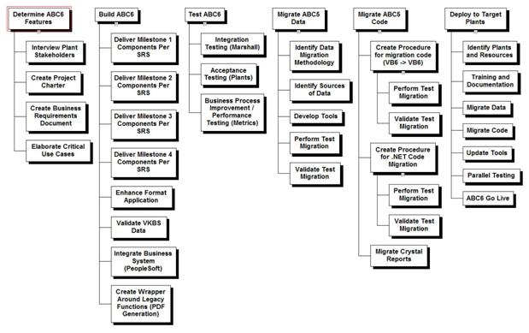
Work Breakdown Structure
Notes:
http://msdn.microsoft.com/en-us/library/bb756611.aspx
Another template tool that can be used is the Work Breakdown Structure. It is often used in project management. This tool is designed to help break down a project into manageable chunks that can be effectively estimated and managed. It can be a visual representation of the high level tasks, and a great one page “birds eye view”, expressing your team’s goal in simple graphic terms. Once you have determined your ground rules, the WBS can be a great team activity to help determine and/or confirm the high level requirements necessary for your project. It is also a great team activity which allows all team members (or if it is a large team, representation from each area) to add input, voice their opinions, note gaps, see how their responsibilities on the project could impact others downstream, who they will need to coordinate their efforts with, and get a chance to hear from other team members regarding their perspectives.
This exercise can be done on a piece of paper or you can take a wall or whiteboard and use post it notes to block out the requirements. Move blocks around depending on priority or the need to consolidate ideas and you can then write on the blocks to see obvious dependencies and who will be taking responsibility.

Slide 16
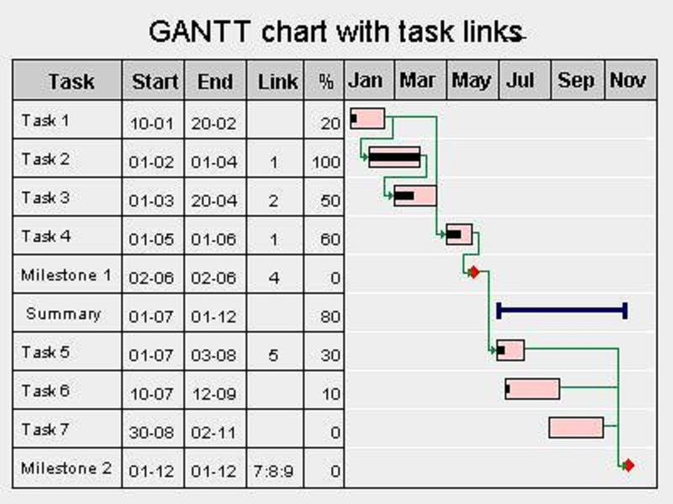
GANTT Chart
Notes:
A Gantt chart is a type of bar chart that illustrates a project schedule broken down by descriptive tasks. Gantt charts illustrate the start and finish dates of each individual task. Some Gantt charts also show the dependency relationships between activities. Gantt charts can be used to show current schedule status using percent-complete shadings as reflected by the black bar within each task.
The chart is commonly known after Henry Gantt, who designed his chart around the years 1910–1915. Gantt charts have became a common feature of web-based applications, including collaborative groupware this chart is also used in Information Technology to represent data that has been collected.

Slide 17
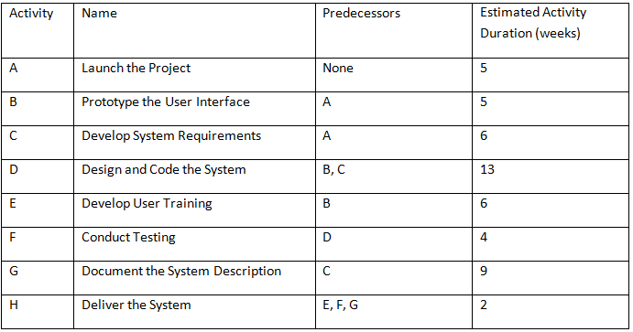
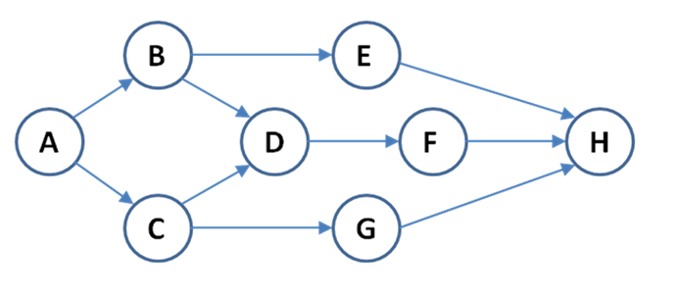
PERT Chart
Notes:
A PERT Chart is a graphic illustration of a project as a network diagram consisting of numbered or lettered nodes (either circles or rectangles) representing events, or milestones in the project linked by vectors (directional lines) representing tasks in the project. The direction of the arrows on the lines indicates the sequence of tasks. PERT stands for Program Evaluation Review Technique.
The PERT chart is sometimes preferred over the Gantt chart, because it clearly illustrates task dependencies. On the other hand, the PERT chart can be much more difficult to interpret, especially on complex projects.
There a many different types of information gathering and process managing tools. It is well worth your time to do a little research online or ask your colleagues which types have worked the best in a similar situation.

Slide 18
Activity II: Developing an Action Plan-Personal Reflection
Consider a project or an important event that you have ahead of you. Use one of the approaches listed above to develop an action plan you believe would be the most appropriate combination of individual tasks necessary toward successfully accomplishing the project or event. After developing the action plan, reflect on why you selected the specific tool you used and how well it worked.

Slide 19
Tools for Teams
Ground rule documentation
Action Plan – action plan templates, project plans, WBS, Gannt, PERT, accountability templates, action item lists
Meeting agendas
Meeting minutes
Data information tables and templates
Notes:
We have discussed ground rules and action plans. These are just two of the tools available to you and your team to document and communicate information and expectations to meet you team’s mission and goals. Other tools include meeting agendas, meeting minutes and various tables and templates to maintain information around your HIT specific project. While documentation may seem time consuming, especially when your project is on a tight schedule and it seems an easy thing to discard, it establishes and maintains the framework for your team. By taking the time to plan appropriately and document effectively, and if you use these tools consistently, they will be respected as the framework documents for the team, aligning individual expectations to team expectations and setting a tone for clear communication. This can go a long way to reducing errors, confusion, frustration and lost productivity.
When you find a template that works for you, and you have customized it to meet your needs, keep it in a toolkit ready for use for future projects.

Slide 20
Unit Assessment: Developing Ground Rules and Action Plan for HIT Team
Providers of an outpatient clinical facility are requesting an upgrade to the current ordering system to include the latest feature of ePrescribing. This will include an upgrade of both the software and hardware of the current system to offer this feature. All providers will use this system for witting patient prescriptions and sending the prescriptions to any of 50,000 regional pharmacies depending on patient requests.
Team composition –
1 Office Manager
2 Nurses
1 Secretary/Receptionist

Slide 21
Unit Assessment: Developing Ground Rules and Action Plan for HIT Teams
Features of the system should include, but not limited to, ability to “write” prescriptions based
on the local formulary of medications, print or transfer prescription either by fax or electronic
interface to the pharmacy of patient’s choice, ability to store a medication history for each
patient including active, inactive and discontinued medications, when medications were last
prescribed, up-coming needs for prescriptions, workflow allowing ancillary personnel to take a
phone request for a new / refill medication for the prescriber to approve before being sent to the
pharmacy, upload of 3rd party information about regional pharmacies, and real time insurance
verification for allowed medications based on insurance coverage.
The requirements set by the clinic for ePrescribing will drive the action plan.
Team composition –
1 Office Manager
2 Nurses
1 Secretary/Receptionist
You are to create initial Ground Rules for the team
You are to create an action plan with the mentioned resources and divide the tasks among the team, assign deliverable due dates and determine when those deliverable dates are slipping.

Slide 22
Summary and Conclusion
Now that you have completed Working in Teams, Unit 3: Ground Rules and Action Plans for HIT related activities, you should be able to:
Create SMART ground rules
Develop a team action plan
Other tools for teams
Notes:
PJ SUMMARY: This unit has provided you with a lot of foundational content for setting-up your team. To have an effective, productive team, smart ground rules need to be set by the team to ensure all are on the board with the task, the work ahead, and how the work will be completed. When teams have input in the guide rules, ownership is felt with the rules more likely being demonstrated throughout the team project since all were involved with the rule construction.
An action plan for the team is an important element as you learned. In this unit we identified several strategies to develop your team action plan. Several other tools for teams were listed that could serve to assist a team in meetings its mission and goals.
Good luck to you as your team work continues to evolve. Don’t forget the ground rules and action plan in order to build your effective, productive team!

