Slide 1
Introduction to QI and HIT
Unit1.2: Relationship of QI and HIT
Notes:
In unit 1.1, you were introduced to the concept of health care quality and the importance of meaningful use of health information technology in improving health care quality. The current unit looks more closely at the relationship between QI and HIT.

Slide 2
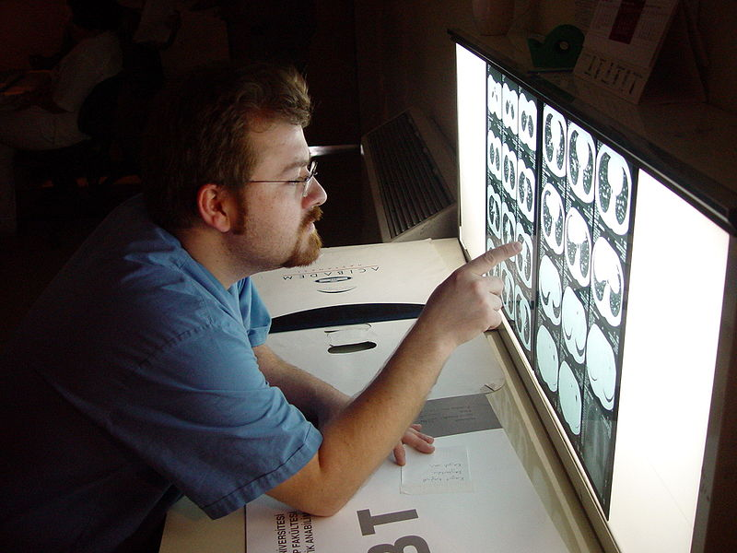
Objective
Analyze the ways that HIT can either help or hinder quality improvement
Notes:
The objective of Unit 1.2 is to analyze the ways that HIT can either help or hinder quality.

Slide 3
Improve individual experience
The best care
At the lowest cost
For the whole population
Improve population health
Control inflation of per capita costs
D. Berwick, Institute of Healthcare Improvement, 2007
Notes:
You have learned about the institute of Healthcare Improvement’s triple aim, which directs all improvement activity toward providing the best care for the whole population at the lowest cost. What exactly is the relationship between HIT and the triple aim?

Slide 4
IHI Triple Aim and HIT
Introduce information tools into clinical practice
Electronically connect clinicians to other clinicians
Use information tools to personalize care delivery
Advance surveillance & reporting for population health improvement
The best care
At the lowest cost
For the whole population
Notes:
Clearly there are ways in which HIT can be used to support the improvement of the individual’s health care experience and the health care outcomes of populations, while controlling health care costs. Four ways in which HIT can help to achieve the triple aim include introducing information tools into clinical practice, using information tools to personalize care delivery, electronically connecting clinicians, and advancing surveillance and population health reporting.
D. Berwick, Institute of Healthcare Improvement, 2007

Slide 5
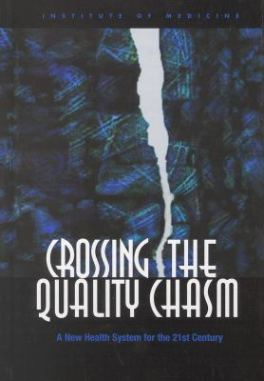
IOM Aims and HIT
Health care should be:
Safe
Patient-centered
Effective
Timely
Efficient
Equitable
Notes:
The Institute of Medicine has set forth 6 aims of quality improvement as part of its national agenda. HIT can both help and hinder the achievement of these aims. Let’s begin with the benefits of HIT.

Slide 6
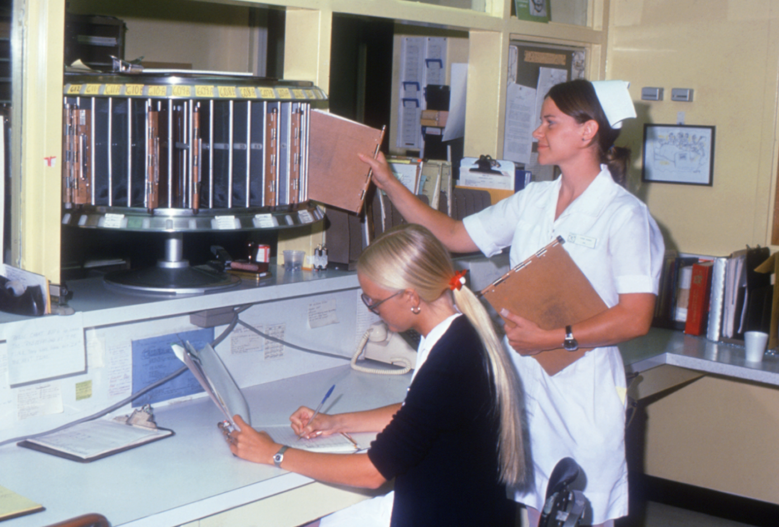
Benefits of HIT
Can lead to improvement of patient safety, efficiency, effectiveness, equity, timeliness, and patient-centeredness
Notes:
HIT can lead to improvement in each of the 6 aims.

Slide 7
Enhancing Patient Safety with HIT
CPOE
e-MAR
Computerized provider order entry
Can reduce errors in drug prescribing and dosing
Computerized medication administration record
Can reduce errors in drug administration
Medical Device Interface
e-Allergy List
Automated vital sign capture
Can reduce errors in transcription
Computerized allergy list
Can reduce errors in preventable adverse drug events
Notes:
Safety is defined as freedom from the occurrence or risk of injury, danger, or loss. When applying the term to patients, we are speaking of protecting our patients from unintentional harm from the care that is intended to help them. HIT has the potential to protect patients from unintentional harm. Computerized provider order entry can reduce errors in drug prescribing and dosing by triggering alerts when does exceed acceptable limits, for example. Medical device interfaces allow for automated capture of vital signs, such as heart rate and blood pressure. This reduces the possibility of error on the part of the human who collects this information by eliminating the transcription step. The electronic medication administration record can reduce errors in drug administration by displaying a record of drugs that have already been administered, and those that are scheduled to be administered. An electronic allergy list can reduce errors by preventing adverse drug eventss caused by administering drugs to which the patient is allergic.

Slide 8
Enhancing Patient Safety with HIT
Knowledge Links
Reminders
Reference information links
Can reduce errors due to lack of knowledge
Prompts and flags
Can reduce errors in omission
Structured Notes
Monitoring
Quality metric reporting
Can identify opportunities for improvement
Standardized observations
Can reduce errors related to failure to detect subtle changes in status
Notes:
Knowledge links can reduce errors by providing links to reference materials when there is a lack of knowledge on the part of the prescriber or the patient. Quality metric reporting can identify opportunities for improvement. Reminder prompts and flags can reduce errors in omission by reminding providers of interventions that are scheduled, and structured notes use standardized observations that can reduce errors related to failure to detect subtle chances in status.

Slide 9
Enhancing Clinical Effectiveness with HIT
Knowledge Links
Reminders
Reference information links to clinical practice guidelines
Can increase use of best practices
Prompts and flags
Can remind provider of recommended interventions
Monitoring
Structured Notes
Quality metric reporting
Can identify gaps in practice
Standardized observations
Can enhance assessment and diagnosis
Notes:
Clinical effectiveness can be enhanced by HIT by providing knowledge links to clinical practice guidelines in order to increase use of best practices; quality measure reporting to identify gaps in practice; reminders in the form of practice alerts and flags; and structured notes to guide provider through standardized observations to enhance assessment and diagnosis.

Slide 10
Enhancing Patient Centeredness with HIT
Knowledge access
Patient portal
Patient-friendly web sites
Can provide medical information and access to support groups
Patient access and manage own health record
Can enable self-management
Tailor to Patient Needs
Disease management
Clinical decision support
Can tailor information according to patient characteristics and condition
Customized health education and disease management messaging
Can enable self-management
Notes:
Patient-centered care is supported by HIT as well. Patient-friendly web sites provide medical information and access to support groups; patient portals allow patient to access and manage their own health records; clinical decision support can tailor information according to patient characteristics; and customized health education and disease management messaging can enable patient self-management.
Additional Resource:
Video: http://www.mc.vanderbilt.edu/root/vumc.php?site=mymedihealth
If this site is available download Vanderbilt My MediHealth video after agree to terms of use (free, need to cite as specified in agreement).
http://www.projecthealthdesign.org/termsofuse

Slide 11
Enhancing Timeliness with HIT
Telemedicine
Clinicians Reminders
Internet-based access
Can provide immediate access to medical information
Task list schedules
Can remind nurses when treatments are due
Time-sensitive Prompts
Patient Reminders
Timed draw alerts
Can remind nurse when to draw blood based on a medication intervention
Appointment scheduling
Can remind patients when they need to return for follow-up visits
Notes:
HIT can support timely care. Telemedicine provides immediate access to medical information through the internet. Task list schedules can remind nurses when treatments are due. Time-sensitive prompts, such as timed draw alerts, can remind nurse when a procedure is due; and patient reminders can let patients know when they need to return for follow-up visits or tests.

Slide 12
Enhancing Efficiency with HIT
Wireless mobile technology
Character expansion
Vital Sign Capture
Can eliminate need to write or type vital signs
Ability to translate a few characters into phrases, sentences or paragraphs
Can decrease typing time
System integration
Clinical decision support
Pull forward historical information
Can reduce data collection time
Prompt for duplicate labs
Can reduce redundant laboratory testing
Notes:
HIT can enhance efficiency in many ways. Wireless mobile technology allows for vital sign capture and can eliminate the need to write or type vital signs. Character expansion allows for the ability to translate a few characters into phrases, sentences, or paragraphs and can decrease typing time. For example, the provider can type a few letters, such as WNL, which can be converted to within normal limits or an entire paragraph describing the normal assessment parameters. System integration allows for pulling forward of historical information and can reduce data collection time. Clinical decision rules can be written to prompt for duplicate labs to reduce redundant laboratory testing.

Slide 13
Enhancing Equity with HIT
Data capture
Multi-Modal functionality
Monitoring by population characteristics
Can uncover health care disparities
Various ways for patients to get health information
Can decrease health care disparity
Tailor to Patient Needs
Decision support
Competency-based patient education
Can tailor information to educational background and development status
Drug cost information
Can assist providers in selecting alternatives for low income patients
Notes:
Finally HIT can enhance equity of health care and services. Data capture can allow for monitoring by population characteristics I order to uncover health care disparities. The multi-modal functionality of systems can allow for various ways for patients to get health information in order to decrease health care disparities. Competency-based patient education can tailor information to the patients educational background and developmental status. Decision support can offer drug cost information to assist providers in selecting alternatives for low income patients.

Slide 14
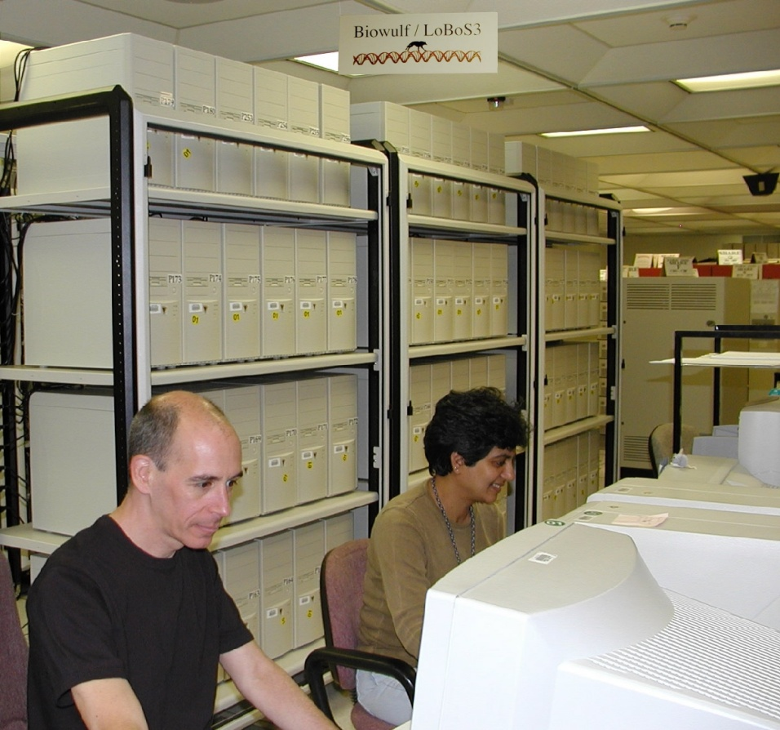
Unintended Consequences of HIT
Work-arounds and artifacts can lead to unintended consequences
Notes:
You’ve seen examples of how HIT can help to ensure quality. But HIT presents a double-edged sword. Poor design and resultant user work-arounds can actually result in unintended negative consequences.

Slide 15
Work-arounds
Defined
Examples
Alternative processes that help workers avoid demands placed on them that they perceive to be unrealistic or harmful
Unanticipated behaviors directly or indirectly caused by the EHR when the system impedes one’s work
Nurses taking verbal orders rather than prescribers entering the order into POE due to workflow timing of event
Significant events located in multiple locations in the EHR due to lack of standardization of data entry screens
Notes:
Work-arounds are alternative processes that help workers avoid demands placed on them that they perceive to be unrealistic or harmful. These unanticipated behaviors can be directly or indirectly caused by the HER when the system impedes the provider’s work. For example, a nurse may take a verbal orders rather than the prescriber entering the order into POE due to workflow timing of the event, such as the surgeon being scrubbed on a case in the OR. Another example is the case where significant events are located in multiple locations in the electronic record due to lack of standardization of data entry screens.

Slide 16
Artifacts
Defined
Examples
Man-made tools that aid or enhance the worker’s thinking abilities
Developed to meet the demands of an activity
Bedside references
Patient locator boards
Report sheets
Documenting on paper then transcribing into electronic record
Notes:
Artifacts are man-made tools that help the worker to think. They are developed to meet the demands of a particular activity. For example, keeping references at the bedside so that the nurse can refer to them during the course of care. Patient locator boards that list names of patients and room assignments so that unit personnel can track where patients are housed. Report sheets that list important patient information for hand-off purposes. Even documenting on paper then transcribing into the electronic record is an aid for the provider to remember data that he or she wants to enter into the electronic record at a later time.

Slide 17
HIT & Workarounds
Dr. Foxwood creates a new order each time he wants to re-order a medication. The nurse enters a verbal order to discontinue the previous medication order, so that the medication will be removed from the electronic medication record. Dr. Foxwood fails to co-sign the discontinuation order because he sees this as an administrative task.
Notes:
So let’s talk about workarounds. You will find that health care providers are expert at creating work-arounds when technology does not fit into their clinical workflow. Here’s an example. Dr. Foxwood creates a new order each time he wants to re-order a medication. The nurse enters a verbal order to discontinue the previous medication order, so that the previous medication will be removed form the electronic medical record. Dr. Foxwood fails to co-sign the discontinuation order because he sees this as an administrative task. Other examples include: drug orders written in a free text message screen causing delay or omission of medications because they are not seen by the pharmacist; data entered into multiple information systems due to lack of interfaces resulting in transcription error’ entering admission and discharges into the system in order to create lab test requisitions. Another example of a work-around would be frequent reviews of the electronic health record every 15 minutes to detect new orders.
Activity
Can you think of work arounds that you have seen in your current job? Why were these created?
Schoville, 2009

Slide 18
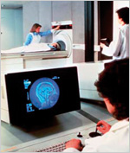
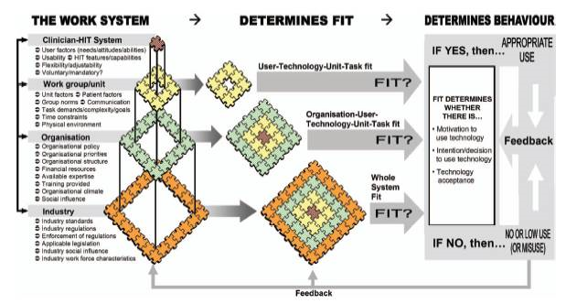
The next three slides describe work-arounds caused by poor HIT design.
1)Patient Armbands
3)Cedar’s Sinai Medical Center
2)Children’s Hospital – Pittsburgh, PA.
Notes:
Click on each of the image captions to learn more about work-arounds caused by poor HIT design.
http://www.nia.nih.gov/NR/rdonlyres/C5BB9FF9-39C4-414A-A0C3-1F825A3A746C/8808/ch3C.jpg

Slide 19
When a bar-coding medication system interfered with their workflow, nurses devised workarounds, such as removing the armband from the patient and attaching it to the bed because the barcode reader failed to interpret bar codes when the bracelet curved tightly around a small arm.
Notes:
Doyle reported that when a barcoding medication system interfered with their workflow, nurses devised workarounds, such as removing the armband from the patient and attaching it to the bed because the barcode reader failed to interpret bar codes when the bracelet curved tightly around a small arm.
Doyle, M. (2005). Impact of the Bar Code Medication Administration (BCMA) system on medication administration errors. Unpublished doctoral dissertation, University of Arizona, Tucson in Nursing Informatics and the Foundation of Knowledge Dee McGonigle, PhD, RN, FACCE, FAAN Kathleen Mastrian, PhD, RN JONES AND BARTLETT PUBLISHERS Sudbury, Massachusetts

Slide 20
Investigators found increased mortality among children admitted to Children’s Hospital in Pittsburgh after CPOE implementation.
Three reasons were cited for this unexpected outcome:
CPOE changed the workflow
Order entry required as many as 10 clicks & took as long as 2 minutes
When the team changed its workflow to accommodate CPOE, face-to-face contact among team members diminished.
Notes:
Han and colleagues reported increased deaths in children admitted to Children’s Hospital in Pittsburgh after CPOE implementation. Three reasons were cited for this unexpected outcome. First, CPOE changed the workflow in the emergency room. Before CPOE, orders were written for critical time-sensitive treatment based on radio communication with the incoming transport team before the child arrived. After CPOE implementation, orders could not be written until the patient arrived and was registered in the system (a policy that was later changed). Second, entering an order required as many as ten clicks and took as long as 2 minutes; moreover, computer screens sometimes froze or response time was slow. Finally, when the team changed its workflow to accommodate CPOE, face-to-face contact among team members diminished. Despite the problems with study methods identified by some of the informatics community, there certainly were serious human-technology interface problems.
Han, Y. Y, Carcillo, J. A., Venkataraman, S. T., Clark, R. S. B., Watson, R. S., Nguyen, T. C, et al. (2005). Unexpected increased mortality after implementation of a commercially sold computerized physician order entry system. Pediatrics, 116, 1506-1512.
http://healthit.ahrq.gov/images/jun09cdsworkflow/09_0054_EF_files/image004.jpg

Slide 21
A Washington Post article reported that Cedars-Sinai Medical Center in Los Angeles had shut down a $34 million system after 3 months due to the medical staff’s rebellion. Reasons for the rebellion included the additional time it took to complete the structured information forms, failure of the system to recognize misspellings, and intrusive and interruptive automated alerts the clinicians’ workflow.
Notes:
In 2005, a Washington Post article reported that Cedars-Sinai Medical Center in LOS Angeles had shut down a $34 million system after 3 months due to the medical staff’s rebellion. Reasons for the rebellion included the additional time it took to complete the structured information forms, failure of the system to recognize misspellings (as nurses had previously done), and intrusive and interruptive automated alerts. Even though physicians actually responded appropriately to the alerts, modifying or cancelling 35% of the orders that triggered them, designers had not found the right balance of helpful-to-interruptive alerts. The system simply did not fit the clinicians’ workflow.
Connolly, C. (2005, March 21). Cedars-Sinai doctors cling to pen and paper. Washington Post, p. A01.

Slide 22
Summary:
When designed well and used as intended, HIT can
Improve safety, effectiveness, efficiency, equity, timeliness, and patient-centeredness of care
Work to accomplish the best care for the whole population at the lowest cost
When designed poorly and subject to work-arounds, HIT can result in unintended adverse consequences
Notes:
In summary, when well designed and used as intended, HIT can improve all of the aims of quality and can work to accomplish the best care for the whole population at the lowest cost. When designed poorly and subject to work-arounds, HIT can result in unintended adverse consequences.

