Slide 1
Reliability, Culture of Safety, & HIT
Unit 3
Notes:
The focus of Unit 3 is Reliability and culture of safety.

Slide 2
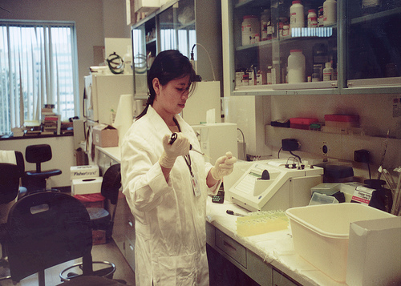
Objectives
Discuss reliability science as a tool for ensuring safety
Examine how ultra safe organizations operate
Identify how teams make wise decisions
Notes:
The objectives of unit 3 are to discuss the notion of reliability science as a tool for ensuring safe quality health care, to examine how ultra safe organizations operate, and to identify how teams make wise decisions.

Slide 3
Reliability
Notes:
We can learn lessons from the Navy with respect to reliability and culture of safety. Click on this video to hear these lessons.
Comp12_unit3_video1
Aircraft carriers are among the most dangerous palaces in the world or at least potentially dangerous – if you think about it there’s these monstrous ships swaying in the waves bouncing up and down and these multimillion dollar airplanes are flying on them – landing on a very short strip that they often have to catch on a wire, - it’s a remarkable feat to watch. Not only that, but they are often staffed by eighteen year olds or nineteen year olds who change every six months – we think about – what safety challenges they have and yet they are among some of the safest places and why is that possible? Well its possible because they have created a culture that respects the front line workers, that understands that they have the knowledge of how to keep things safe and they standardize - they have independent checks – let me give you an example, There was a story about an aircraft carrier that was running a mission and a very senior pilot was flying the mission and they had finished and he was eager- they were all eager to land – I think there were some dignitaries coming to visit the aircraft carrier. And one of the technicians – a mechanic – was out on that landing deck and the plane had been waved in and he was worried that there might have been a a hammer – he may have left his hammer on the tarmac where the plane lands – and obviously if he did it could be disastrous – they could blow out a tire – the plane could explode – and he really wasn’t sure if he did so he ran out and waved off the plane – waved off the plane – the planes are all in formation – and just so you know, these things aren’t trivial – they are enormously expensive – millions of dollars in fuel and staff time and delays they could miss these dignitaries. Turns out that the hammer wasn’t there – there was no real risk, but he thought it was – now in many organizations that mechanic would perhaps lose their job – they would be chastised, and they certainly wouldn’t be rewarded – but in this culture – a culture that respects safety – this worker was rewarded because they said he took the personal initiative to protect other peoples’ lives and the very valuable equipment and, yes he was wrong, but he acted on a good hunch and he was rewarded for that – publically congratulated for his commitment to safety, that is the kind of culture that we need to create in our healthcare environments.

Slide 4
Reliability
Evaluate
Calculate
Improve
Notes:
Reliability science allows us to improve the consistent and standard delivery of high quality, safe healthcare. We are continually evaluating our care, calculating overall reliability of that care, and improving our structures, processes, and outcomes. The Institute for Healthcare Improvement has done a lot of work with reliability in health care quality improvement. They define reliability science as “the measurable ability of a health-related process, procedure, or service to perform its intended function in the required time under commonly occurring conditions”.
http://www.ihi.org/IHI/Topics/Reliability/

Slide 5
Reliability
Prevent Failure
Best practice guidelines, tools, techniques
Awareness campaigns
Memory aids
Checklists
Making the desired action the default
Notes:
To compensate for human limitations, the IHI framework employs a three-tiered strategy. The first line of defense is to prevent the failure from occurring in the first place. This includes putting best practices at the fingertips of the clinician, increasing awareness, providing memory aids and checklists, and configuring the system in such a way as to make the desired action the default. As an IT professional, you will be asked to assist in these efforts using technology to support these aims. For example, you may be asked to recommend IT solutions to prompt clinicians to ensure that clinicians implement the ventilator bundle for all mechanically ventilated patients. A "bundle" is a group of interventions for particular patient populations that, when executed together, result in better outcomes than when implemented individually. The ventilator bundle requires elevation of the head of the bed 30 degrees, daily vacations from sedation and assessment of the patient’s readiness to extubate, measures to prevent stomach ulcers and blood clots, and daily mouth care. Providing each element of care within a bundle leads to more reliable care for patients. Your assistance in finding the best ways to remind clinicians of these measures within the electronic health record will be invaluable.
http://www.ihi.org/IHI/Topics/Reliability/ReliabilityGeneral/ImprovementStories/WhenGoodEnoughIsntGoodEnoughTheCaseforReliability.htm
Identify and Mitigate Failure: Human factors, such as fatigue or distraction, sometimes thwart initial prevention. Techniques to avoid or at least reduce the impact of failure include standing orders for best-practice treatments that can be altered only with written authorization; warnings when an undesirable event is approaching, such as a computer flag when poorly-interacting drugs are prescribed for the same patient; and independent double-checking of required actions.
Redesign for Success: When root cause analysis of persistent failure shows that it is embedded in the system design, redesign is required. It’s necessary to understand where a failure is really occurring in order to figure out the remedy, says Griffin, who offers an example from the automobile industry. “Years ago, there were reports of cars accelerating suddenly, when the drivers swore they were in parking gear. Some of the runaway cars killed or injured people so it was a big liability crisis, but the manufacturers didn’t argue about who or what was at fault for long. They just redesigned their gearboxes so that, today, cars cannot be taken out of ‘park’ unless the driver’s foot is on the brake. Even if the driver is confused, the car won’t let him make a mistake.”

Slide 6
Reliability
Identify and Mitigate Failure
Reduce fatigue and distraction
Standing orders for best practice treatments
Electronic flags
Independent double-checks
Redesign for Success
Understand where the failure is occurring
Determine the remedy
Notes:
The second line of defense is to identify and mitigate failure. There is a growing body of evidence that clinicians are distracted and interrupted constantly during the course of care, and that they can grow fatigued during prolonged shifts. Fatigue and distraction can impede clinicians from preventing failures. HIT offers a variety of options for reducing the impact of failure, such as standing orders for best practice treatments that can be altered only with written authorization, flags and warnings that notify the clinician when an undesirable event is impending, such as drug-drug interaction flags, and configuring the electronic record to accommodate the need for documentation of independent double-checks.
Finally, high reliability organizations redesign for success. They understand where the failure in the system is occurring (through analytic methods such as root cause analyses) and determine the remedy. It is absolutely critical that we understand where the failure is occurring so that we can figure out the remedy. You may have heard early reports of a particular brand of automobile that was accelerating suddenly when their drivers insisted that they were in parking gear. Some of these runaway cars killed or injured people so the manufacturers redesigned their gearboxes so that cars cannot be taken out of park unless the driver’s foot is on the brake. Even if the driver is confused, the car will not let him make a mistake. Just think how many more people would have been injured or killed if the company had decided to argue incessantly about who or what was at fault!

Slide 7
High Reliability Organizations
Hyper-complex
Tightly coupled
Hierarchical differentiation
Multiple decision-makers
Notes:
High reliability organizations survive in complex environments that depend on multi-team systems that must coordinate their respective activities for safety. The safety of a hospitalized patient is dependent on the effective coordination of all members of the health care team. When working on information technology projects, this team includes you as the HIT professional.
High reliability organizations are also tightly coupled. That is, team members depend on tasks across the entire team.
Roles are very clearly defined and differentiated in high reliability organizations. Intense coordination is required for the team to work cohesively. There is no “I’” only “we”. Complete reliance on the team is the hallmark of high reliability organization. Decisions are made by the person with the most direct expertise, not necessarily the team “leader.”
There are multiple decision makers in high reliability organizations, therefore, processes must be in place to allow these decision-makers to communication with eahc other.
http://www.ahrq.gov/qual/hroadvice/index.html

Slide 8
High Reliability Organizations
Complex communication
High accountability
Need frequent, immediate feedback
Compressed time constraints
Notes:
High reliability organizations have complex communication networks. Because they have a high degree of accountability, when errors occur, there are severe consequences. It is not always easy to differentiate patients who die from error from those whose deaths were inevitable due to the course of their disease.
People in high reliability organizations need frequent, immediate feedback. This is essential to anticipate and avert problems before they become crises. Finally, high reliability organizations have compressed time constraints that pose challenges.
http://www.ahrq.gov/qual/hroadvice/index.html

Slide 9
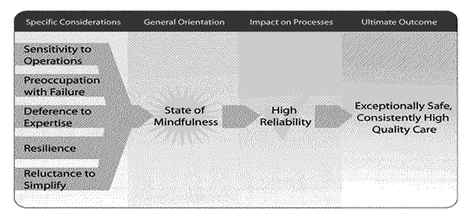
High Reliability Organizations Mindfulness
Notes:
There are 5 concepts that create the sense of mindfulness that is essential for reliability. Mindfulness is the constant awareness that things can and will go wrong.
The slide depicts a flowchart with 4 columns. The first column is titled: Specific Considerations. Five concepts are listed in the column: sensitivity to operations; preoccupation with failure; deference to expertise; resilience; and reluctance to simplify. The concepts flow into the second column, titled: General Orientation. There is a sunburst in the center of the column, with the words: State of Mindfulness. This flows into the third column, titled: Impact on Processes. There is a checkmark in the center of the column, with the words, High Reliability. This flows into the fourth column, titled: Ultimate Outcome. In the center are the words, Exceptionally Safe, Consistently High Quality Care.
Reliable teams demonstrate sensitivity to operations, are preoccupied with failure, defer to expertise, are resilient, and are reluctant to simplify issues. These attributes are necessary to achieve safe, consistently high quality care. While it may not sound like a good thing to be preoccupied with failure, such attentiveness allows team members to pick up on near misses or to identify potentially risky situations. They prepare for failures by learning to perform quick situational assessments, working effectively as a team that defers to expertise, and practicing responses to system failures.
http://www.ahrq.gov/qual/hroadvice/index.html

Slide 10
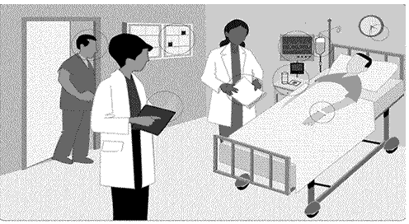
High Reliability Organizations Sensitivity to Operations
Notes:
Sensitivity to operations includes more than just checks of patient identity, vital signs, and medications. It includes awareness by staff, supervisors, and management of broader issues that can affect patient care, ranging from how long a person has been on duty, to the availability of needed supplies, to potential distractions.
The slide depicts a drawing of a man in a hospital bed surrounded by three staff members. The following objects in the room are circled: the face of one doctor, the folder in a doctor's hand, a clipboard, a cabinet, a monitor, pills and glass of water on a table, an infusion bag, a clock face, the identification tag on the patient's wrist.
http://www.ahrq.gov/qual/hroadvice/index.html

Slide 11
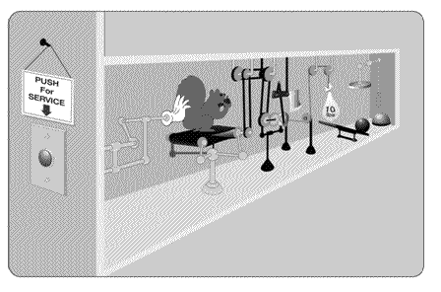
High Reliability Organizations Reluctance to Simplify
Notes:
Oversimplifying explanations for how things work risks developing unworkable solutions and failing to understand all the ways in which a system may fail, placing a patient at risk.
This slide depicts a drawing of a humorous production line. A gloved hand is pushing a squirrel holding a nut. There are many levers, pulleys, weights, hammers, and balls. The goal of the production line is not clear.
http://www.ahrq.gov/qual/hroadvice/index.html

Slide 12
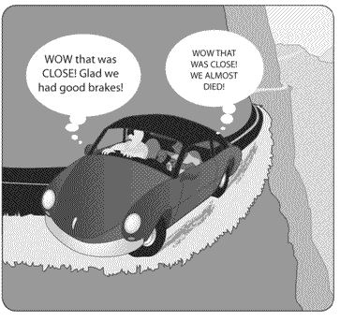
High Reliability Organizations Preoccupation with Failure
Notes:
A preoccupation with failure means that near misses are viewed as invitations to improve rather than as proof that a system has enough checks to prevent a catastrophic failure.
This slide depicts a drawing of a car that has run off the road and is on the edge of a cliff. One passenger is thinking, "Wow that was close! Glad we had good brakes!“ The other passenger is thinking, "Wow that was close! We almost died!"
http://www.ahrq.gov/qual/hroadvice/index.html

Slide 13
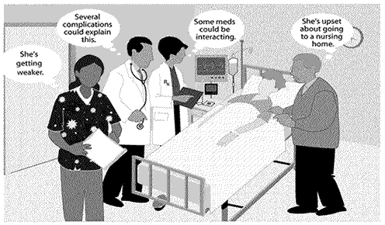
High Reliability Organizations Preoccupation with Failure
Notes:
In many situations, different staff members as well as the patient and family may have information essential to providing ideal care. Deference to expertise entails recognizing the knowledge available from each person and deferring to whoever's expertise is most relevant to the choices being made.
This slide depicts a drawing of a woman in a hospital bed surrounded by three staff members and a family member. The nurse is thinking, "She's getting weaker."
The doctor is thinking, "Several complications could explain this."
The pharmacist is thinking, "Some meds could be interacting."
The husband is thinking, "She's upset about going to a nursing home.“
http://www.ahrq.gov/qual/hroadvice/index.html

Slide 14
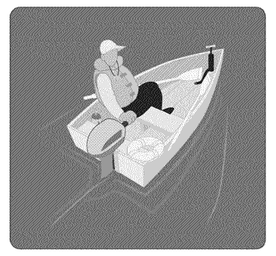
High Reliability Organizations Resilience
Notes:
A good boater never leaves the dock without preparing for many situations that are unlikely but possible. Oars, pump, lifejacket, and fire extinguisher ensure that the boater can quickly respond to unexpected system failures.
This slide depicts a man in a small motor boat. The man is wearing a life jacket and the boat is equipped with a life buoy, fire extinguisher, oars, and a pump.
http://www.ahrq.gov/qual/hroadvice/index.html

Slide 15
Culture
“the shared perceptions of the individuals within the team or an organization about what is good, right, important, valued, supported, or expected at any given time.”
Notes:
I’d like to say a bit about culture. Culture is the shared perceptions of the individuals within the team or organization about what is good, right, important, valued, supported, or expected at any given time. Over time we have seen a shift in the culture of health care from one of blame to a culture of safety.
Riley W, Davis SE, Miller KK, & McCullough M. A model for developing high reliability teams. J Nurs Manag. 2010 Jul18(5):556-563.

Slide 16
The Blame Game
Pointing the finger at people rather than systems
Notes:
I remember vividly the first time I made a medication error. I don’t know how it happened. Maybe I was too much in a hurry. Maybe I was tired. Maybe I got distracted. Whatever. I gave the drug to the wrong patient. Something I always swore I never would do. Maybe I shouldn’t have become a nurse. I was lucky this time because the patient didn’t have a bad reaction to the drug, but what if it happens again? How could I be so careless?
Mistakes hurt. Not only the person at the sharp end of the mistake but also the person who makes the mistake. In times past, the focus was immediately on blame. Who made the mistake? What was wrong with that nurse? Or doctor? What was wrong with me?

Slide 17
Blame
Blame
Stop talking
Learn less
Improve less
Mistakes continue
Vicious
Cycle
Notes:
Blame significantly limits our ability and the ability of others to learn from our mistakes. When we are blamed, we stop talking about the mistake. The quieter we become the less we can learn. The less we learn, the less we have an opportunity to improve conditions that may have contributed to the error. And when we leave conditions as they were, mistakes continue…and someone else will be blamed.
Fortunately, health care is making great strides to shift from a culture of blame to a culture of safety.

Slide 18
Blame
Limits learning
Increases likelihood of repeat errors
Drives self-reporting underground
Culture of Blame
Culture of Safety
Notes:
No one wins the blame game. We don’t learn from our mistakes if we play this game. Therefore, we continue to make errors. And blaming behaviors completely drive self-reporting of errors underground.

Slide 19
Just Culture
Focuses on identifying and addressing systems issues that lead individuals to engage in unsafe behaviors
Maintains individual accountability by establishing zero tolerance for reckless behavior
Distinguished between human error, at-risk behavior, and reckless behavior
Response to error or near miss is predicated on the type of behavior associated with the error, not the severity of the event
Notes:
While "no blame" is the appropriate stance for many errors, certain errors do seem blameworthy and demand accountability. This leads to the concept of "just culture“ A just culture focuses on identifying and addressing systems issues that lead individuals to engage in unsafe behaviors, while maintaining individual accountability by establishing zero tolerance for reckless behavior. It distinguishes between human error (eg, slips), at-risk behavior (eg, taking shortcuts), and reckless behavior (eg, ignoring required safety steps), in contrast to an overarching "no-blame" approach still favored by some. In a just culture, the response to an error or near miss is predicated on the type of behavior associated with the error, and not the severity of the event. For example, reckless behavior such as refusing to perform a "time-out" prior to surgery would merit punitive action, even if patients were not harmed.
http://psnet.ahrq.gov/primer.aspx?primerID=5

Slide 20
How to Promote a Culture of Safety
Accept responsibility
Value learning from mistakes
Learn to recognize risky behaviors
Notes:
You can help to promote a culture of safety. First, accept responsibility for ensuring patient safety. Value learning from mistakes. Often HIT designs need to be reconfigured when the current configuration does not support patient safety. Learn to recognize risky behaviors in others and in yourself.

Slide 21
How to Promote a Culture of Safety
Speak up if something is not right
Listen to others & discuss ways to prevent error
Take action to reduce risk
Notes:
Speak up if you see that something is not right. Perhaps someone is using the electronic health record in a way that differs from the intent. Speak up and provide information to that individual so that they understand the way in which the system was designed. Listen to them and discuss ways to prevent error. Take action to reduce risk.

Slide 22
How to Promote a Culture of Safety
Report errors & near misses
Encourage others to report errors & near misses
Help change unrealistic policies
Notes:
Report errors and near misses that come to your attention. Encourage others to do the same. Help change unrealistic policies or rules.

Slide 23
Culture of Safety Characteristics
Carefully LISTEN to the concern to determine if corrective action is necessary
Recognize when a concern is expressed by anyone and STOP
Notes:
There are two extremely important characteristics of a culture of safety. They typify the attributes of high reliability organizations by requiring a high degree of mindfulness, teamwork, and communication. First, all must listen carefully to concerns to determine if corrective action is necessary. Second, every member of the team must recognize when a concern is expressed by anyone and STOP.

Slide 24
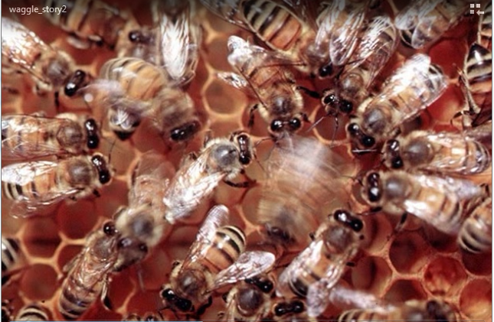
Culture of Safety
Notes:
Play video to learn some final lessons from nature on how teams make wise decisions in a culture of safety.
Comp12_unit3_video2
There’s a fascinating science how why teams make wise decisions. And the teacher comes from a rather surprising place – honeybees. Honeybees are known in biology as being among the best decision makers we have. That is, they go to select a new hive with remarkable accuracy. And how they do it has been the study of many economists and decision makers and it really could inform your work in information technology. What they found is that the queen bee sends out scouts who go and look for a new hive. The scouts go and they test out a place and they come back and they do this thing called the waggle dance. Essentially they shake their butts in proportion to how long or how much they like the new hive, so a longer waggle means it’s a really good hive – a shorter waggle- not a good hive. And then other bees see who’s waggling a long time and they go test it out with them – they go “hey let’s go check out this hive, and they come back and waggle and the potential hive that gets the longest collective amount of waggles is where they pick for a new hive. It’s remarkably efficient and effective. And what some researchers found is if they made decisions based just on what that first scout came back with – they often made decisions quickly, but wrong. On the other hand, if they didn’t have a forum to go test – and share – and go test out that new hive, they eventually made the right decisions, but it took them a really long time because they didn’t share wisdom. That balance of independence and interdependence is what we need to achieve in healthcare IT development. And use – what we need to do is not have management on high dictating here’s how your going to design something because they will predictably get it wrong. It has to be tested by users. But the users also need a forum to share with each other – to talk to go test – and to come collectively agree on what’s right. That way to replicate what the honeybees (do) is something we’re going to be asking you to do in making decisions for healthcare IT.

