Slide 1
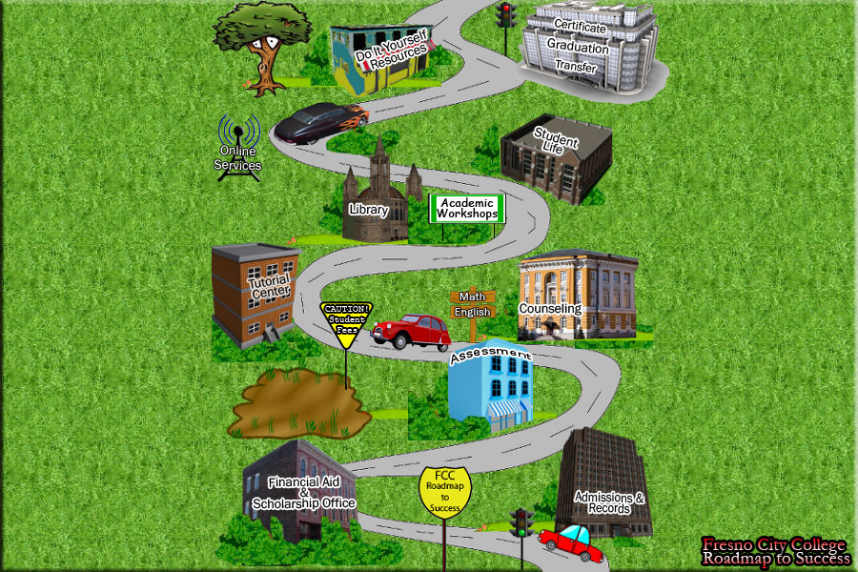
ROADMAP TO SUCCESS

Slide 2
What’s your plan?
Get a counselor
http://www.fresnocitycollege.edu/index.aspx?page=1728
Complete an education plan
http://www.fresnocitycollege.edu/index.aspx?page=2950
Take relevant courses
http://www.fresnocitycollege.edu/index.aspx?page=1377

Slide 3
Classroom Tools
Study Skills
Time Management
Professionalism
Health Issues

Slide 4
Connect to Fresno City College!
FCC WISE http://fccwise.fresnocitycollege.edu/pages/fccwise_complete/index/index.html
Student resources
http://fccwise.fresnocitycollege.edu/pages/fccwise_complete/Resources/Resources.html
Student activities
http://www.fresnocitycollege.edu/index.aspx?page=2774

Slide 5
Get Help!
Tutoring
http://fccwise.fresnocitycollege.edu/tutorialcenter/searchtutor/search.php
Reading and Writing Center
http://fccwise.fresnocitycollege.edu/pages/fccwise_complete/wrc.html
The Library (Librarians are your friends)
http://www.fresnocitycollege.edu/index.aspx?page=31

Slide 6
Career Preparation
Internships
Jobs
Resume Workshops
Professional Behavior

